Slide 1
Leadership and assertive communication

Slide 2
Overview
Understanding leadership: contemporary ideas and the RCM’s focus.
Exploring responses to language around assertiveness.
Leadership and assertive communication in the MSW/MCA role.
Notes:
Give an overview of the session, stress that attendees should feel free to ask questions and tell stories as we go along.
We’ll be unpicking some challenging words: leadership and assertiveness, and exploring what they mean to us as individuals and in the context of the MSW/MCA role.

Slide 3
Are you a leader?
Notes:
To introduce the section, ask attendees to think about whether they would consider themselves leaders. If yes, why? And if not, why not?

Slide 4
Leadership according to MSW/MCAs
Inspires and motivates
Willing to share information
Leads by example
Good communicator
Team player
Passionate
Mediator
Helicopter view
Diplomatic
Self-motivated
Approachable
Proactive
Empowerment
Good listener
Using initiative
Notes:
Rather than producing an abstract list of traits and characteristics, this slide from an MSW leadership study day
MSWs were asked whether they considered themselves leaders, and they universally said they did not. We then asked them to consider characteristics of people they have worked with, who they would see as leaders.
Once the words had been identified on post-it notes (these are the words on the slide), we asked whether the MSWs could see themselves acting according to any of those words – and of course, they were able to say yes. Which begs the question, why do you not see yourself as a leader then?! The key point is that we’re trying to move away from the ‘heroic’ leadership model, and towards one where leadership is something we all hold within us.
This may result in a discussion about how we see ourselves differently in the workplace compared to being at home –and this is a really useful discussion, so if it happens let it flow!

Slide 5
Leadership: from traits to complexity
Trait: definition of leadership
Process: definition of leadership
Leader
Height
Intelligence
Extraversion
Fluency
Other traits
Followers
Leader
Interaction
Followers
Notes:
This slide is a tiny window into leadership theory – where it began, and where it is now. It’s a bit simplified, but it demonstrates the key points.
The image on the left is a more traditional view: the leader at the top of the tree, and the followers somewhere below. It also suggests that leadership is all to do with individual traits and characteristics of the prescribed leader – the bit about height and intelligence comes directly from the earliest leadership theory, which was based on the world of soldiers. The critique of this model is based on the idea that not everyone who has the long list of traits will be an effective leader; and not all effective leaders have all the traits (and there are hundreds, if you count all the early theoretical work!)
The image on the right is how we think of leadership now: leaders and followers work together through interaction which flows up and down the hierarchy. So leadership becomes all about relationships and interaction – moving away from the top down model. Now, we might describe followers as the anvil of leadership – very powerful!
I often add the caveat that leadership sometimes doesn’t behave itself according to contemporary theory: just think, Donal Trump!!

Slide 6
Emotional intelligence
The ability to understand and manage our emotions;
Five key elements:
  Self-awareness;
  Self-regulation;
  Motivation;
  Empathy;
  Social skills
‘If your emotional abilities aren’t in hand, if you don’t have self-awareness, if you are not able to manage your distressing emotions, if you can’t have empathy and have effective relationships, then no matter how smart you are, you are not going to get very far’
(Daniel Goleman)
Notes:
This slide expands a bit on what is required for contemporary leadership, given its emphasis on relationships.
Emotional intelligence used to be seen as a bit ‘soft’, but it’s now considered the cornerstone of effective leadership – essentially, it’s all about knowing ourselves and understanding how we relate to others. You can see how that fits with contemporary leadership thinking, as that’s all about relationships.
I’m not a fan of an ‘either/or’ approach to things, so I always point out that emotional intelligence and IQ work well together – one isn’t better than the other!
The author of that quote, Daniel Goleman, is one of the main architects of emotional intelligence research. If you’re worried about not knowing enough on this subject, search for him on YouTube and you’ll see his work. Here’s a link to a brief overview of emotional intelligence that you might find useful:
https://www.mindtools.com/pages/article/newCDV_59.htm

Slide 7
When we’re not assertive, we risk being:
Passive | Aggressive | Passive-aggressive
Results from people failing to express their feelings, wants and desires, instead putting others first Communication is often apologetic, indirect or needy Giving in to others’ demands – detrimental effect on self | Where people forcefully put themselves and their own needs ahead of others Communication may be loud, intimidating, controlling and demanding Can have a detrimental effect on others | Often the result of true feelings being hidden, may result in defensive, sulky or vindictive behaviour May happen when an individual feels unappreciated, insecure or generally unhappy Negative effects for self and others
Notes:
You can relate these boxes to the answers on the previous slide. Again, people seem happy to talk about times when they’ve felt like this or experienced these behaviours from others.

Slide 8
Leadership according to MSW/MCAs
Inspires and motivates
Willing to share information
Leads by example
Good communicator
Team player
Passionate
Mediator
Helicopter view
Diplomatic
Self-motivated
Approachable
Proactive
Empowerment
Good listener
Using initiative
Notes:
This slide illustrates the key point about contemporary leadership theory and the relevance of emotional intelligence. This is the same slide as you saw earlier – but now look at the number of words and phrases identified by the MSWs that are about interpersonal relationships (the ones in pink). Any one of these demonstrates the importance of self-awareness, which is a key element of emotional intelligence.

Slide 9
Leadership from the RCM’s perspective
Leadership is the ability of an individual, or a group of individuals, to influence and guide others in an organisation. It involves being heard, asking difficult questions, making hard decisions, creating and sharing a vision, establishing achievable goals and providing followers with the knowledge and tools necessary to achieve those goals.
The RCM believes that leadership is a role for everyone rather than exclusively senior colleagues at management level’.
https://rcm.org.uk/leadership/
Notes:
Our commitment to offering development opportunities to midwives and maternity support workers.
Key point is the bit in bold at the bottom – we’re echoing contemporary leadership theory within our leadership offer: leadership is everybody’s business.

Slide 10
Assertive communication
Notes:
So how does this relate to assertive communication? Essentially, in order to hold leadership within ourselves and in our roles (wherever they happen to be in what is essentially a highly hierarchical organisation, despite what the NHS likes to say about taking a distributed, collaborative approach to leadership ☺) we need to be able to have challenging conversations.
Introduce the section by saying that we’re going to unpick one of the key leadership qualities, which is about being able to communicate effectively.

Slide 11
Communication
The message
Behaviour/output
Information/input
The channel
Speaking, writing, graphics, video etc
Coding
De-coding
The messenger:
what I mean
The recipient:
What I understand
At least some code in common
Notes:
Let’s start with communication – it looks so simple, doesn’t it? You communicate something, the other person receives it – job done!
However, as we’ve all experienced, that bit in the middle can be incredibly complex, and what you want to be understood by the recipient may well be lost somewhere in the translation.
See if you’ve got any stories to tell about times when communication has not worked well – either as the person giving out a message or as the recipient.
For example – my husband had to learn that humour in text messaging may be completely misinterpreted by the recipient… ☺
Consider such things as body language and other non-verbal communication. All these things have an impact on how the bit in the middle of the picture happens.

Slide 12
What’s in a word?
Assertive
Notes:
Have a discussion about understanding and interpretations of the word ‘assertive’. You might do this in small groups, depending on the dynamic in the room – sometimes small groups work better for discussing challenging things.
Consider also what assertive means to you – is it a comfortable word?
You might well get responses and stories that include words like bossy, tactless, rude… Or you might not! Again, stories often work well in these discussions, if you have any to share about being/trying to be assertive, or times when you’ve been on the receiving end of other people’s assertiveness!
Explain that we’re going to unpick what assertive is and isn’t, and how it relates to effective communication.
If you’d like to explore assertiveness, here’s a useful link:
https://www.skillsyouneed.com/ps/assertiveness.html

Slide 13
Leadership: from traits to complexity
You’re asked to attend a networking event and arrive to find you don’t know anyone. Do you:
Spend a long time in the bathroom, skirt the room feeling embarrassed and then leave early without speaking to anyone;
Bowl up to a group of people who are in an intense conversation and interrupt so you can tell them who you are and what you do;
Look for others who are on their own or in twos, introduce yourself and ask what they do;
Feel aggrieved that anyone would put you in that situation and walk out.
Notes:
This exercise is a talking point, just to get people thinking about what assertiveness looks like – and what other behaviours we might be prone to.
Perhaps get a show of hands for each of the possible answers, and get some chat going about how people feel in situations like this.
If you’d like further examples to use for discussion, there are lots more here:
www.janesunley.com/Assertiveness-Questionnaire
Answers:
A is passive
B is aggressive
C is assertive
D is passive-aggressive
The next few slides go into more details…

Slide 14
Top tips! Reducing problematic behaviours
Passive | Aggressive | Passive-aggressive
Aim to not allow passivity to take over – identify passive behaviours and their triggers, and consider how more assertive behaviours could be substituted Force yourself to try out alternative behaviours – start small! | Work on emotional intelligence – developing empathy. Identify own unacceptable behaviours and their triggers. May need to ask others Work out other ways to let off steam, and learn to remove yourself from trigger situations | Aim to control your response, even if you can’t control events Consider positive and proactive responses Would honesty, sympathy and tact be more effective?
Notes:
Ways to deal with our own and others’ behaviours. It’s all about self-reflection and self-awareness – you can relate this back to what we were discussing earlier on the subject of emotional intelligence and leadership.
Stories work really well on this slide – particularly the box about passive-aggression!

Slide 15
What is assertiveness?
The ability to express oneself honestly, directly and appropriately;
At the same time, respecting the opinions, wishes and feelings of others;
Standing up for own rights while respecting the rights of others – balancing own and others’ needs
Your needs
Aggressive
Others’ needs
Passive
Assertive
Notes:
Just to contrast assertiveness with the other three behaviours. Again, you can see the link with contemporary leadership and emotional intelligence, given the emphasis on considering self and others.
Here’s a link to more on assertiveness in leadership:
www.leadershipexpert.co.uk/importance-assertive-leadership.html
The Venn diagram is a useful summarising tool.

Slide 16
What assertiveness is not
Being aggressive, demanding or demeaning
Being critical, sarcastic, nasty or ironical
Beating around the bush, being vague and indirect
Being indecisive and apologetic
Notes:
This just offers a reminder of what assertiveness is not. It will probably be useful to link this back to the original discussion about what people think assertiveness is – and unpick things they’ve experienced that turn out to be e.g. aggressiveness. It’s also a good way to dispel some of the fears people may have about appearing assertive.

Slide 17
Overview
Authenticity
Self-esteem and confidence
Respect for self and others
Competent communication and social skills
Being comfortable with yourself
Being in control of your voice tone and physical mannerisms
Notes:
Link this back to emotional intelligence, and also the slide with the little clouds, in which MSWs described leadership behaviours they’ve seen (and understand within themselves).
The last bullet point also links back to the slide on communication – see how self-awareness helps us to behave assertively.
All of this plays into the RCM message that leadership is not about hierarchies – rather, it’s about learning and owning positive behaviours and mindsets.

Slide 18
Assertive communication in the MSW/MCA role
Examples and challenges?
Notes:
To contextualise the discussions, it would be good at this point to summarise what assertive communication might look like in the MSW role. I’m sure attendees will have examples of challenges associated with using assertive communication as an MSW.
If you get some good stories, it will be useful to refer back to these in the final few slides, which consider strategies and tools to help MSWs use assertiveness in communication.

Slide 19
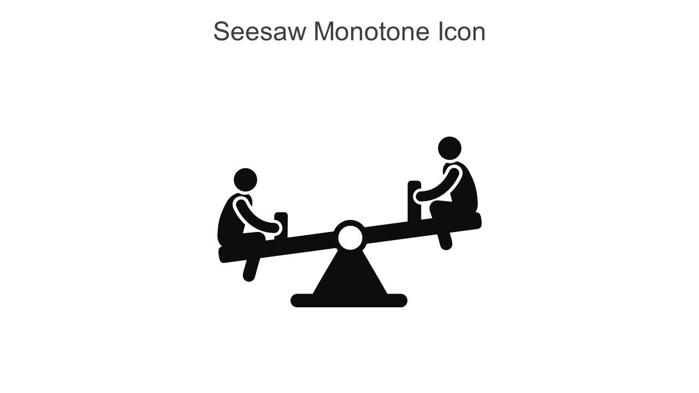
Communicating with an assertive mindset
Value yourself
Voice your needs and wants confidently
Acknowledge that you can’t control other people’s behaviour
Express yourself positively
Be open to criticism and compliments
Learn to say ‘No’
Use assertive communication techniques
Notes:
The image is to depict the need to balance own and others’ needs when communicating assertively.
I really like this text box, because it talks about changing our own mindset as a first step. Valuing ourselves might link back nicely to discussions and stories from practice (the previous slide) – and also to that contemporary idea of leadership as something that happens within ourselves. If we begin at a place of valuing ourselves, we have a better chance of communicating with confidence.
Relate this also to emotional intelligence – this is how we prevent assertiveness from slipping into aggression, because we’re thinking about our own needs alongside those of the people we’re communicating with.

Slide 20
Trying new ways of communicating
Gaining confidence
Engage empathically
Establish win-win partnerships
Understand the other person
Listen first
Be understood by the other person
Communicate your point of view clearly
Discuss the issues logically and rationally
Reach agreement
Notes:
This is a process through which MSWs might try out assertive communication. There probably won’t be time to do much in the session, but you could relate the process back to stories they’ve told from the workplace.
The steps:
Engaging empathically – reading the other person. If you know them well, you’ll have an idea of how to get them onside from the outset. For example, are they the kind of person who likes a bit of chat before getting down to business? Or would they prefer to just get on with it? Starting from a place of ‘what we share’ is often useful.
Listening first – this is a really good way of not getting caught on the back foot. If you start by putting your own point first, you risk sounding aggressive, and also not knowing what’s going to come back at you. By listening first, the other person feels heard from the outset.
Step three is made easier by the fact that you’ve listened to the other person, so you can reflect their points/concerns in your own communication. Clarity is everything, so make sure you’ve spent time considering your argument.
Given that both points of view should have been aired, there should be more hope of a rational conversation – because everything’s already in the open.

Slide 21
The learning process
Unconscious competence
Unconscious incompetence
Conscious incompetence
Conscious competence
I’m ok as I am – there is no need to change and learn this. I have enough skill in this area already
I can do this without thinking now – it just flows
I have the hang of this now
I would feel very self conscious using that model – what if I fail?
Notes:
If we’re going to be thinking about using assertive communication in the workplace (or in fact in others areas of our lives), then we can apply this learning process.
We begin with unconscious incompetence (we don’t know what we don’t know) and work round the cycle. You’ll notice it doesn’t end with unconscious competence, but instead the cycle begins again. That’s an acknowledgement that even when we think we know how to do something, it’s always worth reflecting that we might need to reconsider our own understanding at times.
This slide is a nice way to support attendees in moving forward and trying out assertive communication – it acknowledges that the learning process can be tough, but that it’s generally worthwhile and results in new levels of competence and confidence.

Slide 22


