Slide 1
Human factors

Slide 2
Learning outcomes
Understand
Understand that human factors is on the national midwifery agenda
Understand
Understand the main human factors
Learn
Learn from examples of human factor errors in maternity

Slide 3
Human factors
Notes:
Human factors theory and practice, first developed in the aviation industry, recognises that humans make errors, and therefore systems should be designed to help prevent humans from making errors. It also recognises that telling staff not to make the same mistake again may not prevent the error from reoccurring. ‘Human factors’ are an important way for us to understand what effects how health professionals perform their role. Using a human factors approach can be helpful when seeking to improve safety in maternity care. A human factors approach encourages us to acknowledge the impact of a range of factors on safety and performance. These include: • Equipment – ease of use, training to use • Physical environment – noise levels, distractions • Fatigue – impact of working patterns, ability to take breaks, staff access to nutrition and hydration • Stress – workload and information overload, need to multi-task, team working practices and communication style • Preparation for task or role – knowledge and skill of professionals • Team working – style of leadership, hierarchy, approaches to supporting staff

Slide 4
Notes:
The 2014 MBRRACE-UK maternal report highlighted ‘fixation error’ that must be avoided by being sure to 'always consider other possible diagnoses in the event of failure to respond to treatment of the initial presumed cause of illness'. The Morecambe Bay report described 'repeated instances of failure to communicate important clinical information about individual patients' as well as highlighting that 'working relationships between staff groups were extremely poor'.
Generally, Each Baby Counts reviewers interpreted ‘human factors’ as being human errors and the means to overcome them as ‘human factor training’. Whilst experience from the aviation industry and some early experience from obstetrics suggests that such training can be effective, connections to improved obstetric outcomes have yet to be made. Nontechnical skills training, human factors training and crew resource management all attempt to improve the abilities of healthcare providers to analyse and make sense of what is going on around them, to improve their situational awareness, team working and communication. Although not linked directly to improvements in outcomes, human factors training will raise awareness that human factors exist. Such training should standardise certain elements such as communication, understanding of personal bias, personality and team working.
HSIB Skin to skin. https://www.hsib.org.uk/investigations-and-reports/neonatal-collapse-alongside-skin-to-skin-contact/

Slide 5
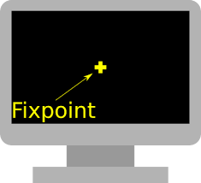
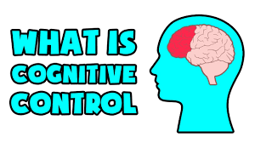
Human factors
The captain’s attention was narrowed because he was stressed; he focused only on the task in front of him – this is known as task fixation
The captain ignored distracting stimuli. This is called cognitive control. For example, the captain ignored the time and the concerns of others in order to focus fully on the landing equipment
The crew failed to speak up
Notes:
The United Airline's disaster raised an awareness of human factors and how these contribute to errors, this accident happened over 40 years ago.
The crash was almost certainly preventable. This plane came down because it ran out of fuel and the captain was not aware. The captain was focused on an error with the landing equipment and this consumed all of his attention. The crew noticed the fuel was running low, and tried to alert the captain. But the captain did not register their concerns and the plane ran out of fuel.
GROUP WORK – THINK OF SOME REASONS WHY WE MAKE ERRORS?

Slide 6
Pre course videos
Notes:
Discuss – the videos then pre course watching and discuss the solution below and how it works in their workplaces.
The solution is to ensure that the leader is not performing tasks. The leader needs to stand back, give instructions, and maintain the helicopter view. In maternity emergencies it is important that the leader adopts the helicopter view, so that they are not involved in manual tasks which absorb most of one’s attention. By having a leader who is able to step back and observe the situation, task fixation cannot happen because the leader is not performing the task, therefore situational awareness is preserved, which is the process through which decisions are made.
It would be helpful when simulating obstetric emergencies, to mark a line on the floor behind which the leader would stand so that they are not able to become involved in practical tasks.
What do you do in your workplace?
Add in clip from 24 hours in A&E with leader directing

Slide 7
Group work
In groups discuss what a good structure in the maternity unit looks like.

Slide 8
The structure – what good looks like in maternity: human factors
Appropriate skills mix and task allocation on each shift.
Allocation of breaks at the beginning of the shifts and ensuring these breaks are taken in a timely manner.
Ensure there are facilities provided to ensure that staff are able to re-stand maintain hydration and nutrition during their working hours.
Recognition of pressures on staff during busy periods and seek to provide relief or support for those under pressure.
Learning lessons from previous incidents to improve practice through regular shared team reviews of key learning.

Slide 9
The structure – what good looks like in maternity: human factors
Teams undertake training together.
Regular, focussed team communication using daily briefings or huddles and debriefing techniques.
Any potentially unsafe behaviours are constructively challenged. Negative behaviours are challenged.
Staff encouraged to take adequate time off to recharge and not book bank shifts during annual leave.
Review roster rules report to ensure equitable allocation of shifts and ensure work life balance is supported

Slide 10
Self check-in: key human factors when working under pressure

Slide 11
Self check-in: key human factors when working under pressure

Slide 12
Self check-in: key human factors when working under pressure

Slide 13
Self check-in: key human factors when working under pressure

Slide 14
Cognitive control and task fixation
Trauma video from 24 hours in A&E
https://youtu.be/8lvgYmcLbKk

Slide 15
Case study
Probe
Gain attention or raise a concern
Alert
Repeat this concern
Increase your volume
Challenge
Formally state concerns and challenge the individual’s decision
Emergency
Get eye contact and potentially take over the task
I am unfamiliar with the evidence underpinning your decision, could you teach me?
I am concerned about the safety of the unborn baby or woman
We need to consider an alternative plan to improve safety
I am going to seek a second opinion as this is a safety issue
Would you like me to seek a second opinion
Notes:
Pick out a case study and add this in.
Recall and event that was task orientated ie was it that consultant who didn’t let you speak up. How can you change the situation? Mention incivility in the workplace. Highlight poor behaviours.

Slide 16
Halt
Have you noticed/considered?
Ask did they hear/consider your suggestion?
Let them know that this is a patient safety issue
Tell the team to STOP until the consensus agreement supports that it is safe to continue
Notes:
Discuss Leeds hospital – Buddy scheme has a agreed term of reference. Can challenge . What are the arrangements in your organisation. How confident are you in challenging? What would you do if someone didn’t agree.? What would you do if someone didn’t agree?

Slide 17
Notes:
In Groups think of other Human factors to be aware of.

Slide 18
Human factors
Other human factors to be aware of
Fatigue
System design
Misplaced saliency
Migration of boundaries
Complexity creep
Interruptions
Notes:
Fatigue - Being tired reduces our working memory, cognition and brain power and therefore it is harder to maintain situational awareness.
System design - System design involves our environment, for example, the location of handover, the layout of paperwork or even where we locate the emergency drugs.
We can make many errors because of poorly designed systems. The HSIB (2019) reports a case where the wrong patient details are attached to a blood sample. It recommends that there is system redesign to create an electronic system for identification, blood sample collection and labelling.
Interruptions - Interruptions distract us from the task in hand and can cause us to forget what we were thinking, it is best not to interrupt someone who is performing an important task such as checking medication. Just wait a few moments, we can let them know that we are waiting until they have finished.
Migration of boundaries - This is when we believe that something is acceptable because it is what everyone else does. For example not recording the FH on a CTG during the siting of an epidural.
A recent HSIB investigation for retained tampon after childbirth found that staff had ‘drifted’ away from ideal practices due to competing task demands, limited handover periods, task pressure, and a motivation to go home on time. In order to prevent this drift (or migration) in practice they recommend that NHS England/Improvement carries out its intention to commission and publish an independent evaluation of its alternative design for swabs and tampons (HSIB 2019).
Misplaced saliency - This refers to picking out the wrong information and considering it to be the most pertinent. To avoid this work as a team, two heads are better than one as highlighted earlier
Complexity creep - This involves increased complexity without seeing improvements in safety. For example, a checklist or documentation aid which is difficult to follow in an emergency or is, at worst, incorrect.

Slide 19
Case study
This example takes place on a busy antenatal ward. The ward is short staffed, the phone is ringing and several women require medication. There are two midwives on shift: a junior midwife and senior midwife. A senior clinic midwife arrives on the ward and hands over care of a 35 week primigravida to the junior midwife.
During handover, the senior midwife asks the junior midwife to sign a CTG saying: "Could you just sign this for me quickly, it's normal".
The junior midwife classifies the CTG as normal and continues attending to the handover.
What do you think contributed to the incorrect classifying of this antenatal CTG?
Notes:
Discuss – the videos then pre course watching and discuss the solution below and how it works in their workplaces.
The solution is to ensure that the leader is not performing tasks. The leader needs to stand back, give instructions, and maintain the helicopter view. In maternity emergencies it is important that the leader adopts the helicopter view, so that they are not involved in manual tasks which absorb most of one’s attention. By having a leader who is able to step back and observe the situation, task fixation cannot happen because the leader is not performing the task, therefore situational awareness is preserved, which is the process through which decisions are made.
It would be helpful when simulating obstetric emergencies, to mark a line on the floor behind which the leader would stand so that they are not able to become involved in practical tasks.
What do you do in your workplace?
Add in clip from 24 hours in A&E with leader directing

Slide 20
Rephrasing questions
This CTG is normal isn’t it?
Or
How would you categorise this CTG?
Notes:
Rephrase questions..Don't lead the questions. Encourage colleagues to make there own decision.

Slide 21
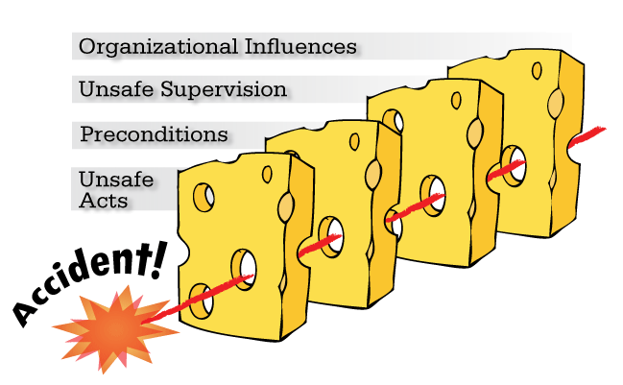
The HFACS Framework
The HFACS Framework
Notes:
HFACS - The Swiss-cheese model takes a systems approach to accident investigation. With this approach, human error is viewed as a symptom of a larger problem in the organization, not the cause of the accident. Within an organization, barriers are established to prevent adverse events. To be most effective, multiple levels of barriers should be established. Reason argues that most organizations have established four separate levels of barriers. The four levels of barriers are sequential in nature, meaning that those levels at the top affect the levels below. Within each level, failures can cause holes in safety barriers. These failures can either be active, those occurring immediately prior to an accident and directly impacting events, or latent, those removed temporally from the event and not exhibiting a direct impact But what exactly are these holes in the safety barriers and how can they be systematically identified?

