Slide 1

Building confidence and advocating culture change

Slide 2

Learning outcomes
Develop a basic understanding of what confidence is
Develop an understanding of what confidence is not
Identify and understand areas of your life where you feel/are confident
To increase personal and professional confidence
Ways to use your confidence
Understand factors which can lead to poor maternal and neonatal outcomes
Improving confidence in challenging poor behaviours

Slide 3
What do you think are the qualities of someone who is confident and someone who is not confident?

Slide 4

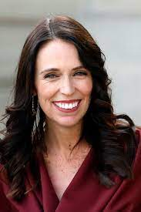



Confident people?
Michelle Obama
Michelle Yeoh
Jacinda Ardern
Emma Raducanu
Helen Mirren
Notes:
Are these people really confident or just extrovert. Some can be perceived as bullies. Discuss in a group icebreaker.
? Ask them to identify their own “confident” individuals – what are their qualities. Personally and professionally.

Slide 5
What do you think are the qualities of someone who is confident and someone who is not confident?

Slide 6
Qualities we associate with confident people
Qualities
Headstrong
Extrovert
Fearless
Loud
Charismatic
Gregarious
Talkative
Notes:
Allow people to have a conversation thinking about what confidence is and isn't.
Making people feel comfortable and relaxed.
Are these characteristics of a confident person? Add in ?
Can you use Jam pad and post its to share with the group
You don’t have to be outgoing to be confident you can have quiet people who are calm and confident.

Slide 7
Reflection
How has our perception of confidence been influenced by media/social media and celebrity status?
Confidence doesn’t always mean being the loudest voice.
Being loud, headstrong, extroverted, fearless, charismatic and talkative may be signs of a confident person – but these do not define confidence.
Confidence manifests itself different in every single one of us.
Notes:
Liz
Reflection on what makes them feel confident and what situations. Confident women often seen as obnoxious or loud or troublemakers.

Slide 8
What does a confident midwife /MSW look like?

Slide 9
What does a confident Midwife/MSW look like?
Recognises limits
Ability to say NO
Supportive
Recognises difficulties or issues to be sorted
Knows it's okay not to be expert in everything
Safe practitioners ask questions
Notes:
Rae. In groups what does a confident midwife look like? Outline of a midwife picture what does that look like.
Could being confident help you raise concerns? Knows how to raise concerns.
Confidence to say yes? In your own ability?
Confidence to help others raise a concern
All would hopefully come out in the group discussion
?Self doubt – how is it managed? Some self doubt can be useful – strategies to manage it “not sweating the small stuff” Self compassion and kindness.
We can all make mistakes
There is a risk of confidence becoming arrogance.

Slide 10
What consequences could lack of confidence have on women in our care and staff?

Slide 11
Consequences of lack of confidence
Poor outcome due to lack of communication
Feeling bullied, unable to say no.
Feeling undermined
Undervalued
Made to feel stupid
Hinder ability to achieve goals
Women do not feel safe in your care
Reluctance to seek help
Fear of admitting making an error
Notes:
Group work. What consequences could lack of confidence have for staff and women?
Lack of confidence to stand up to someone e.g escalation. Might be reluctant to seek help – leading to poor outcomes, women may feel more anxious. May appear stupid to colleagues – can have long term consequences
Example at school when you put your hand up to ask a question and are made to feel stupid so therefore you don’t ask any more questions in class. This could be the same in the workplace for example when you want to transfer a woman from for eg the birth centre to delivery suite.

Slide 12
What can we do when our confidence has taken a knock?
Seek help from our trusted friends/family or GP
Practice some simple assertiveness techniques
Be as kind to ourselves as we are to others
Watch out for "negative self talk"
Make use of KIT days/OH
Ask, ask, ask questions
Remember – you are not alone
Notes:
The list above is not exhaustive. What else can you add?
PMA, clinical supervisor
KIT - Keeping in touch days are available to use if you are off on maternity/parental leave. These allow you to work various hours to help keep you up-to-date with policies/protocols/ mandatory training, etc. All designed so that you don't loose confidence in your skills and abilities
Use your Occupational Health service if returning after a period of extended absence, they can help with half days, no on call commitments, etc for a short time. But vital time that allows you to settle back in and regain your self confidence
Confidence isn't always static. It needs to be ‘topped up’ from time to time and can be depleted by life’s challenges. Working individually, think of a time when a life event knocked your self confidence. How did you pick your self up or gain back your self confidence. What worked for you? Share with the group if you feel you can.
Utilise any training opportunities that you may have been given and complete these sooner rather than later, this will help you to feel more confident in your knowledge
Make reference to the I-learn modules on assertive communications, etc.
Remember it may take longer than some to feel comfortable on returning to work, this is natural as we are all individuals, try not to compare yourself to other or your colleagues.

Slide 13
On 10 December 2020, the interim report from the review into the Shrewsbury and Telford Hospital NHS Trust maternity services, led by Donna Ockenden, was published.
The final report was published on 30 March 2022
Notes:
On December 10th 2020, the interim report from the review into the Shrewsbury and Telford NHS Trust maternity services, led by Donna Ockenden, was published.
This interim report is based on review of 250 cases – there will be final review in late 2021 to include 1,862 cases. The review so far is based on interviews with women and families rather than interviews with staff.
The report combines midwifery and obstetric issues, describing them as ‘maternity issues’.

Slide 14

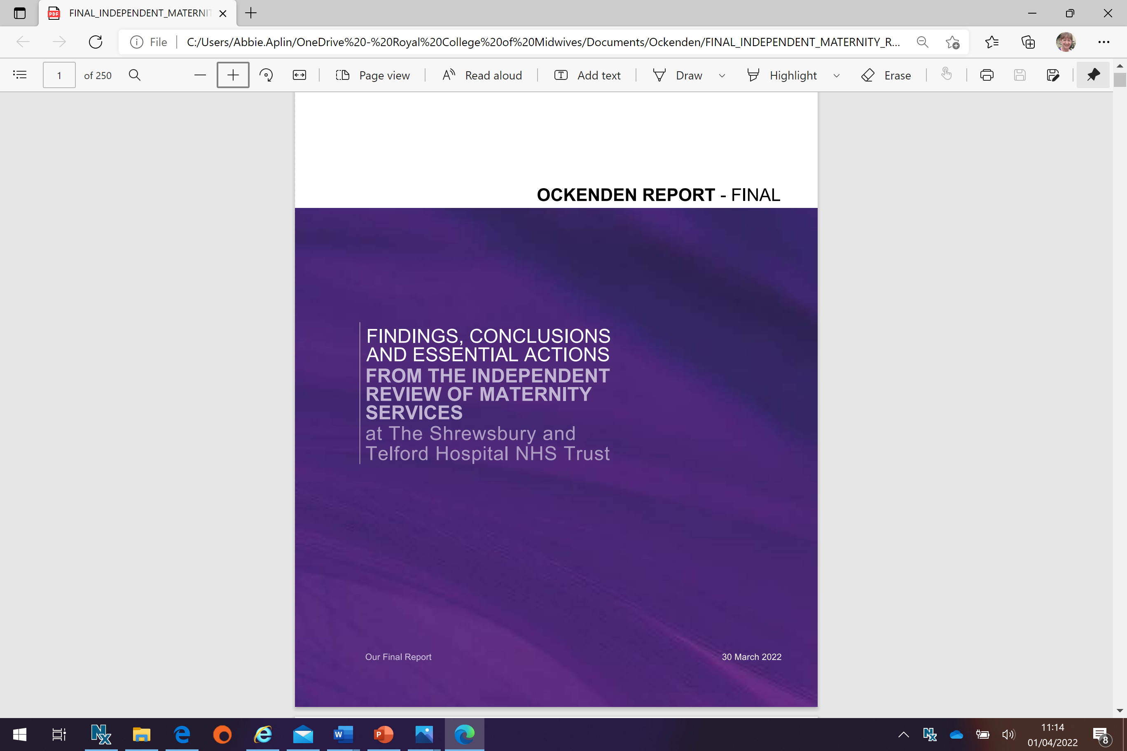
Ockenden Report Final March 22
Ockenden states:
“SaTh failed to investigate, failed to learn and failed to improve and therefore failed to safeguard mothers and babies at one of the most important times in their lives”

Slide 15
History and background
The Ockenden review commissioned by SOS Hunt in 2017
Interim Ockenden report Dec 2020 - 250 cases, 27 Local actions and 7 IEA’s.
Government investment March 21 of £95.6m for 1200 MWs, 100 Cons, backfill for training and support for NQM’s.
Final Ockenden report March 22 - reviewed the experiences of 1,486 families, linked to 1,592 serious incidents from 2000-2019.
HSCC June 21 recommended £200-£350m to improve safety.

Slide 16
History and background
Until 2017 SaTH Maternity Services was viewed as having some issues but not a major risk and generally favourable.
10 reviews of the service 2000-2017 including 2 CQC reports and an RCOG invited review were undertaken but no one took responsibility and accountability to see actions through including the need to improve poor governance.
Ockenden states the timeline “shows the failure of the Trust’s maternity services to listen to families and to learn from critical incidents spanning the entire period of the review”
Missed opportunities to “investigate, inform and listen”

Slide 17
Key themes
Patterns of repeated poor care
Poor staffing
Lack of training
Poor governance structures to embed learning which could have prevented further deaths /poor outcomes
Failure in leadership
Failure to escalate
Systemic failure to investigate
Lack of response, transparency and honesty with families
Poor culture and working relationships

Slide 18
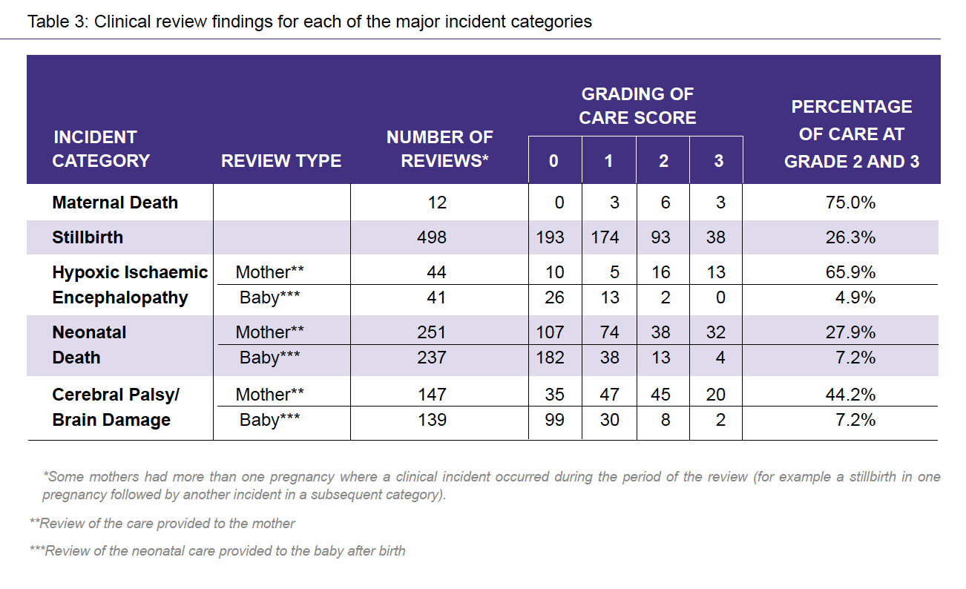
Cases reviewed revealed significant or major concerns in care

Slide 19
Local actions for learning for SaTh, the wider system and actions for RCM
64 Local actions for learning for SaTH
15 IEA’s to improve care and safety in maternity services across England
Letter from Ockenden to SOS -RCM recommendation
DHSC and NHSE/I must now commission a working group independent of the MTP that has a joint RCM and RCOG leadership to make plans to guide the MTP around implementation of those IEA’s and the recommendations of other reports currently being prepared.
Point 15.8 Pg 243
Endorse the recommendation that training targets should be enforced by NHSE/I, MTP, RCM, RCOG, and CQC through a regular collaborative inspection programme
Pg 162 IEAs Workforce planning and sustainability -essential action financing a safe maternity workforce
The feasibility and accuracy of the BR+ tool and associated methodology must be reviewed nationally by all bodies inc NHSE, RCOG, RCM, and RCPCH

Slide 20
15 immediate and essential actions to cover 10 key areas:
Finance a safe maternity workforce
Essential action on training
Escalation and mitigation to Board when short staffed
Essential roles for Trust Boards in oversight of maternity services
Meaningful investigations with family and staff and practice changes should be introduced in a timely manner
Mandatory joint training across all care settings
Mandatory joint learning across all care settings when a mother dies
Specialist care of mothers with complex and multiple pregnancies
Ensure the recommendations from the NCCR 2019 are introduced at pace
Improve PN care for unwell women
Improved care of bereaved families

Slide 21
15 IAE’s
1 Workforce Planning & Sustainabilty
2 Safe staffing
3 Escalation and accountability
4 Clinical Governance and leadership
5 Clinical Governance-Incident reporting and complaints
6 Learning from maternal deaths
7 MDT Training
8 Complex Antenatal Care
9 Preterm Birth
10 Labour and birth
11 Obstetric anaesthesia
12vPN Care
13 Bereavement Care
14 Neonatal Care
15 Supporting families

Slide 22
Key Issue 1: lack of Internal oversight, governance or external accountability.
The report describes a service which lacked ‘organisational memory’ – with a very high turnover in senior leadership at Board level. 10 CEOs in 20 years.
Lack of Governance: There was a long term and consistent lack of adequate investigation into serious events. Many of the internal reviews were done by one profession, not MDT.
Consistently excluded families from investigations.
The Trust was also found to have had inadequate risk management and reporting mechanisms, with no root cause analysis.
incidents that should have triggered a Serious Incident investigation were inappropriately downgraded to an internal investigation methodology known as a High Risk Case Review (HRCR), which had the effect of concealing the real prevalence of incidents
Lack of MDT input into guideline development or audit; lack of updating of guidelines
Clique among Supervisors of Midwives, ‘marking own homework’

Slide 23
Key issue 1: Lack of governance – direct quotes from staff
‘The Republic of maternity, where, often, the maternity service seemed to consume its own smoke and didn’t like having oversight from the corporate team’ (p12)
‘reviews of serious incidents seemed to take a long, long time to happen and there was an impression of evasiveness around how the learning from those reviews was shared’ (p12)
‘practice wasn’t evidence based but there was nobody qualified, competent or capable to update guidelines or to even write guidelines’ (p48)
It [the RCOG review] was presented to us, I think, by SaTH as being more positive than it actually was. It was kind of oh well, the RCOG think we’re OK’ (p186)

Slide 24
Key issue 2: Significant, chronic staff shortages
The shortage of consultants meant that midwives wishing to escalate concerns found it difficult to obtain a timely obstetric review and resulted in delays to the instigation of appropriate medical management
Shortages of obstetric anaeshetists meant that women at risk of complications were not reviewed in a timely way by anaesthetists, leading to anaesthetists needing to respond to significant acute ermergencies with no preparation. There were also delays for women accessing epidural analgesia in labour and being transferred to theatre, due to a lack of anaesthetic cover.
Shortages of midwives resulted in the labour ward coordinator role only being supernumerary for 50% of the time. The fact that the coordinators had women under their own care for whom they were responsible, limited their ability to support junior midwives and doctors and to maintain a ‘bird’s eye’ view of the labour ward.
Labour ward managers and lead midwives had unmanageable workloads, leading to key issues being overlooked.
Midwives working in the midwife led units and postnatal wards were frequently ‘pulled’ to cover the short staffed labour ward, leading to gaps in staffing in these areas.

Slide 25
Key issue 2: Significant, chronic staff shortages
‘it was really clear just how difficult it was to sustain a safe level of cover’ (p187)
‘I asked for a Birthrate plus review…which, surprise, surprise, really showed everything that we’d felt – deficit of 30 whole time (posts)’ (p187)
…the midwives, they were obviously short-staffed…the shift leaders was constantly having a patient…’ (p187)
‘it was scary, it was a system issue, as in this lady need to go and we can’t get her, she can’t go, there aren’t enough midwives, you know’ (p187)
‘Nobody went out at any time wanting to harm anybody, it’s just we didn’t have the training and we didn’t have the staff and that’s how it was, unfortunately and we didn’t know any different’ (p187)

Slide 26
Key Issue 3: Poor workplace culture and bullying
A lack of trust between midwives and obstetricians was described.
There was also a lack of trust between hospital based midwives, particularly a ‘clique’ of labour ward coordinators and midwives based in the community midwife led units.
Low number of staff who took part in review (90) – some stated they were discouraged from taking part
Lack of MDT training, or MDT collaborative working on audits, reviews, change management
Of those staff who did engage with the review team, while some indicated that they felt that the culture was positive, around half highlighted significant concerns around bullying behaviours.
A lack of psychological safety for staff is described throughout the report. It is identified that one to three consultants intimidated midwives and junior doctors.
Asking for help was seen as a bad thing and junior staff were too frightened to ask for support.

Slide 27
Key issue 3: Poor workplace culture and bullying, lack of compassion within team and with women and families
‘Descriptions of physical trauma, pain, lack of attention, vulnerability, unkind words, swearing, sarcasm and bullying towards women as well as unkind treatment of colleagues, amongst midwives and obstetricians have been found to be widespread throughout the review period’ (p106)
‘I think bullying was rife on the maternity unit and this is part of it, that these consultants, there were one or two or even three that would intimidate the midwives and junior doctors and make sure that they are not approachable’(p189)
‘there were fallings out between the Band 7s and the consultants, I remember there being arguments…’ (p189)
‘There are some really good people who care immensely about what they do but operating in a system that is in crisis management continually, can have significant impact on the ability to maintain passion and compassion’ (p183)

Slide 28
Key Issue 4: Poor clinical care
Failings are identified in the report for all aspects of maternity care: antenatal risk assessment and management, supporting informed decision making, inadequate guidance and guidelines for all aspects of care; inadequate management of women with medical and obstetric complexity including multiple pregnancy, diabetes and hypertension;
Intrapartum failings included failure to reassess risk and recommend change to planned place of birth due to change in circumstances; delay in transfer from MLU; lack of identification of deterioration of the fetus, inadequate intermittent auscultation and recording keeping of IA; lack of identification of deteriorating CTG; lack of escalation; lack of response by coordinators and medical staff to midwife’s escalation.
Desire to keep caesarean section rates low – injudicious use of syntocinon ++; multiple attempts at vaginal operative deliveries with up to 3 instruments before going for CS.
Lack of postnatal care – very limited bereavement care; no consultant follow up after readmission; lack of detection and treatment of 3 & 4 ‘ tears.

Slide 29
Key Issue 4: Poor clinical care
‘and they were always very proud of their low caesarean rates…I personally found all the failed/attempted instrumental deliveries very difficult to deal with. I had never seen so many injuries/HIE/resuscitations from this’ (p188)
‘ a woman was admitted with postnatal faecal incontinence, but was not seen by a consultant until 4 days after admission’ (p110)
‘they failed to respond adequately to problems arising during labour, failed to make appropriate clinical decisions and failed to respond in a timely manner to signs of impending serious complications such as severe hypertension and significant antepartum haemorrhage’ (p105)
‘An hour prior to birth…the midwife sought assistance for possible uterine rupture. A ventouse delivery was initiated 35 minutes later…The outcome of uterine rupture, early neonatal death and major obstetric haemmorhage was classified as low harm’ (p18)

Slide 30
NHSE response
Letter from Amanda Pritchard, Ruth May and Steven Powis
£127 million over next two years, in addition to the £95 million

Slide 31
The RCM response

Slide 32
RCM response
Media release: RCM response to Ockenden review into maternity services at Shrewsbury and Telford
Blog from Head of Health and Social Policy: Time for the Government to stop ducking its responsibility on staffing (rcm.org.uk)
All member newsletter
Set up multi-disciplinary round table to discuss the report and our joint actions in response
All staff briefing
PowerPoint deck for use at Activists training and branch meetings

Slide 33




Solution Series: Leadership, learning from reviews, human factors, culture
Standing up for high standards
Safer staffing and Raising concerns position statements

Slide 34
RCM professional guidance
Informed decision making
Thoughts for upcoming guidance:
Diabetes, multiple pregnancy, hypertension – I learn on medically complex care;
Joint guidance on syntocinon use and operative births
MIDIRs searches on key topics

Slide 35
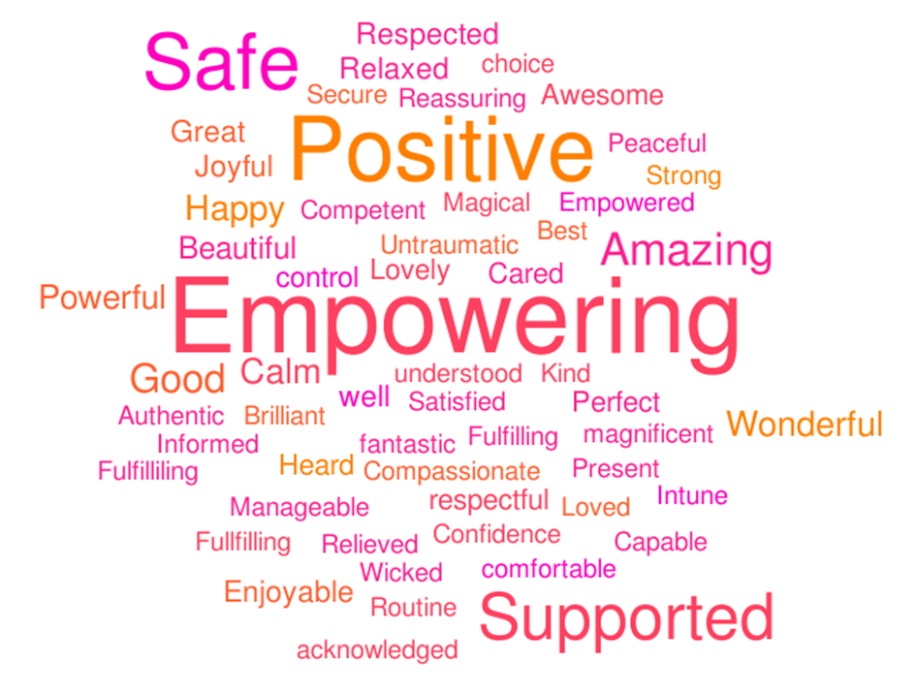
The Re:Birth project
Women have told us that they want professionals to ask them what language they want to use to describe their birth and reflect that back to them;
No one type of birth should be preferenced or celebrated more than another; language that implies failure should stop
They want evidence based information not opinion

Slide 36
Recommendations from previous investigations
New guidelines not appropriately shared with staff
Staff not made aware of guidelines or part of the guideline development
Staff feeling that the guidelines are unnecessary or that they apply to someone else
No audit of practice or review of outcomes
Lack of leadership in implementing guidance
Failure to learn lessons
Notes:
Recommendations from previous maternity reviews and local investigations had been put in place in some instances, but “failed to create the intended effect of improving maternity care”.
What reasons can you think of that guidelines and recommendations did not improve outcomes?
Is this something that is familiar in your workplace. Discussion around this.
The situation regarding physiological ctg ie not all staff trained, not nice guidelines

Slide 37
Personal culture checklist
Smiled and greeted a colleague even though I didn’t know them
Introduced myself to a colleague who I don't know
Thanked anyone who helped me in some way -even if they were just doing their job
Thanked or complimented a colleague at the end of a shift for something they did that shift
Washed up other people's mugs or cleaned up a mess made by someone else without complaining to anyone
Made a colleague laugh
Reached out to a colleague who seemed upset or not themselves, to offer them support
Made a positive suggestion about how to change things for the better
Challenged a colleague who was talking about someone negatively
Challenged a colleague who behaved inappropriately to a colleague / reported it to a manager
Made tea for my colleagues
Helped a colleague without being asked
Swapped a shift with someone when asked -without moaning to them or anyone else
Backed a colleague (including a manager) publicly who had an idea that I thought was good
Smiled and greeted a colleague even though I didn’t know them
Introduced myself to a colleague who I don't know
Notes:
Which of these have you have done in the workplace – How did it make you feel.
What behaviours in your workplace would you like to change?
In Groups discuss how you think you would be able to change attitudes/behaviours in the workplace.

Slide 38
Personal culture checklist
Ignored a colleague when they came into the coffee room
Ignored a colleague when they came into the coffee room
Criticised a colleague's clinical care to someone else
Criticised a colleague in front of a woman/patient/family
Left mess for others to clear up
Made a colleague l augh at the expense of another member of the team
Gossiped about a colleague
Only raised objections and negatives when someone was suggesting a potential change
Joined in with a colleague who was talking about someone negatively
Ignored seeing a colleague belittle, bully, shout or undermine another colleague
Shown favouritism to my friend on shift when allocating work
Expected a newly qualified or new member of staff to be able to work independently
Rolled my eyes when I didn't like what someone had said
Talked over a colleague at handover or during other work conversation
Backed a colleague (including a manager) publicly who had an idea that I thought was good
Something else that I feel wasn't great
Notes:
Which of these have you have done – how would you feel if someone responded to you this way.
What behaviours in your workplace would you like to change?
In Groups discuss how you think you would be able to change attitudes/behaviours in the workplace.
Discuss being aware of why others have treated you that way. – Stressed, busy.

Slide 39
Workplace culture checklist
Using the handout describe the culture of your unit. Consider what you see and hear, not what you feel and think.
Who seems to be accepted and who doesn’t? What is it about those who are accepted as compared to those that aren’t?
What kinds of behaviour get rewarded? e.g. getting along, getting things done, other behaviours?
How is the culture reflected in the systems adopted by the unit and the symbols it uses to illustrate the culture?
What does management pay the most attention to? e.g. budgets, problems, successes, crises, other behaviours?
Are decisions made? e.g. by one person, discussion and consensus, are decisions made by all?
Notes:
Group work – look at checklist

Slide 40
Advocacy
Advocacy means getting support from another person to help you express your views and wishes and help you stand up for your rights.
Someone who helps you in this way is called an advocate. Midwives are advocates for women as is the RCM.
Example : The RCM advocates for equitable access to midwife–led services for women because we know that midwives are the key to improving health outcomes for women and their baby's during childbirth. It also advocates for women in its campaign against FGM and in trying to increase the number of midwives in practice.
Notes:
Not an advocate at all costs ensure you document everything and explain why you have made these decisions. Informed choice.
Mention PMA

Slide 41
How can midwives advocate for women?
Embedding learning from incidents in practice
Working to improve practices as a result of patient complaints and staff complaints
Using evidence based guidance to inform practice
Facilitating the implementation of research findings
Any active contribution to a quality improvement activity (not necessarily in a clinical setting)
Undertaking audits
Notes:
Ask the question before you put the slide up?

Slide 42
Escalation
Does your unit have an escalation pathway for when you have concerns about a woman during her care? If so, review the pathway and consider whether the approach for escalating concerns is clear.
It is good practice to undertake a case review where there is a poor outcome or a serious untoward incident. How are cases reviewed in your unit? Make notes on the procedure, speak to a colleague to see of you can observe the process.
Notes:
If you feel bullied or see someone being treated badly what is the escaulation in your unit?

Slide 43
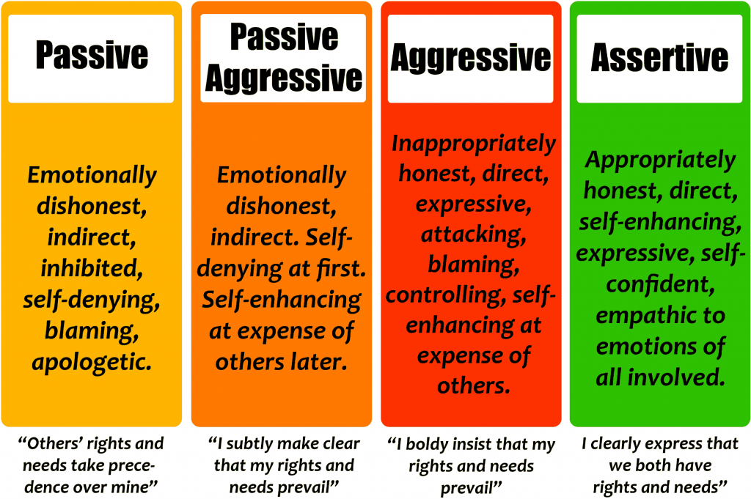
Assertiveness
Notes:
Assertiveness is the quality of being self-assured and confident without being aggressive. Think about barriers to assertiveness.
Sometimes difficult to identify true assertive behaviour because there is a fine line between assertiveness and aggression and people often confuse the two.
Rae. In groups what does a confident midwife look like? Outline of a midwife picture what does that look like.
Could being confident help you raise concerns?
Confidence to say yes? In your own ability?
Confidence to help others raise a concern
All would hopefully come out in the group discussion
?Self doubt – how is it managed? Some self doubt can be useful – strategies to manage it “not sweating the small stuff” Self compassion and kindness.
We can all make mistakes
There is a risk of confidence becoming arrogance.

Slide 44
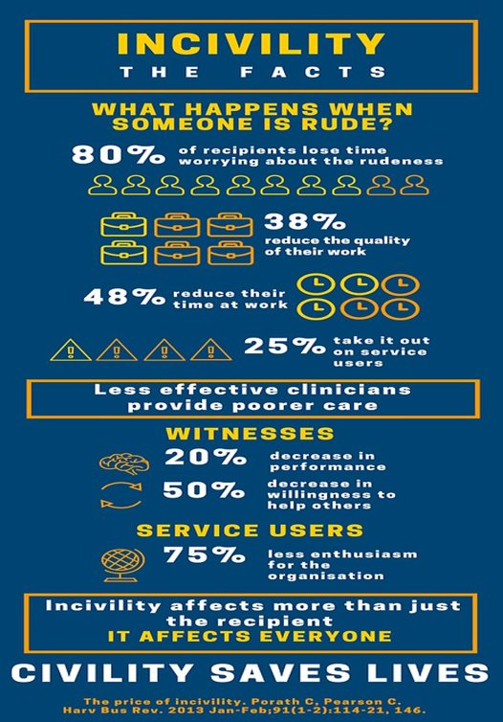
Civility and kindness
Notes:
Groupwork – How does it make you feel when someone is rude to you?
What do you do if you see a colleague being spoken to rudely or talked about?
The NMC Code clearly talks about prioritising people, being kind, compassionate and respectful. Visit the NMC pages and download a copy of the Code.
Treating people with kindness and respect appears not only to improve outcomes but also helps with how the families feel about the outcomes.
Chapter 4 in the report raises fundamental aspects of care that were missed, for example choice of birth place with an informed risk assessment. Failings in working as a team and not escalating concerns.
If maternity staff are unable to work effectively as a team, it is unlikely that concerns will be heard. If midwives feel that colleagues don’t listen to their concerns, then they will be reluctant to escalate. However, if the midwife fails to see that there is a clinical risk and doesn’t seek help, the team cannot work together to provide care (see section 4.20 of the report).

Slide 45

Incivilities

Slide 46

Caring for you
Mental health first aid
Wellbeing workshop
Occupational health
Working with the menopause
Know your limits – It is okay to say no. Switch off
It is ok to have fun
RCM caring for you hub www.rcm.org.uk/caring-for-you-hub-home/
RCM Podcasts www.rcm.org.uk/c4y-podcast/.
Notes:
RCM resources - The RCM has lots of resources that you can access we have workshops available such as working with menopause. Going through the menopause can leave you feeling unsure of yourself, and this is where you can lose a lot of you confidence as you suffer symptoms such as brain fog and forgetfulness.
SWITCH OFF - Remember to say no it is vital that you have downtime, you may feel great however volunteering to cover sickness and filling in gaps in service will eventually take its toll on your physical and mental wellbeing.
OCCUPATIONAL HEALTH – Most workplaces have open access to staff. Utilise the services available.
FUN – Try not to talk all the time about issues that are affecting you. It could be a sign of not coping if you talk about your problems all the time or not talking about it at all. It is important to offload and work through these issues but if you do not switch off from these they can soon take over all of your life.

Slide 47
Immediate and essential actions –Ockenden report
i-learn module: Human Factors: reducing errors in maternity care
https://qualitysafety.bmj.com/content/early/2020/09/25/bmjqs-2020-010988
https://www.rcog.org.uk/en/careers-training/workplace-workforce-issues/workplace-behaviour/joint-statement-undermining-bullying/
www.rcog.org.uk/WPBtoolkit this has loads of tips and good videos on civility
Seven features of safety in maternity units: a framework based on multisite ethnography and stakeholder consultation | BMJ Quality & Safety
https://www.rcm.org.uk/media-releases/2021/march/effective-and-inclusive-leadership-a-key-factor-in-improving-safety-says-rcm/
Notes:
Please can you highlight - RCM Effective and inclusive leadership is a key factor in improving safety in maternity services. That’s the message from the Royal College of Midwives (RCM) as it launches the second instalment in its new Solution Series. The interim Ockenden Review, published earlier this year, and other reviews of failed maternity services often identify a failure in leadership or poor leadership.

Slide 48


