Slide 1
Social media and networking
Notes:
Welcome
RCM Virtual Meeting Rules
*Note that some of this information is taken from the i-learn course.

Slide 2
Learning outcomes
Making the most of the opportunities that social media networking can bring
Ensuring that you network safely online and understand the importance of protecting your information
Managing the boundaries between personal activity and professional activity on social media
Recognising the advantages and disadvantages of social media
Understanding your professional obligations and being aware of your employer's policies on the use of IT and social media

Slide 3
Social media
On the whole, social media has brought the world closer together. It has never been easier to know what's going on as it happens, think news bulletin push notifications.
Technology and social media are making a positive difference, with more information available and accessibility to information e.g. to promote better health, raising awareness of issues surrounding climate change, or highlighting social movements such as Black Lives Matter.
Notes:
The 21st century's birth of social media has in fact brought about a new set of mental disorders and conditions. Since the turn of the millennia, a new fleet of illnesses has surfaced, such as phantom ringing syndrome (thinking the phone’s ringing when its not) and nomophobia, the dear of being without your smart device, and other side effects ranging from cybersickness to dependence issues. Despite the shocking levels of connectivity that we see today, social media has revolutionised that idea of keeping up appearance. For better of worse people have a desire to share content on the web, but could these urges be doing more harm than good, particularly in the workplace.

Slide 4
Social media
It’s vital that you remember that no matter what you post, like, share, tweet or re-tweet that it will be online for forever, even if you delete something there is always a way for it to be retrieved.
Be aware of privacy issues, online postings can be shared and passed onto a much wider circles of people without your knowledge or permission.
What you might have thought was a private posting only available to a small circle of friends can soon be shared with a much wider audience.

Slide 5
Social media – positive uses
Notes:
Social media campaigns – What makes them successful?
whether it’s inclusivity, hard-work, fun, or individuality, use your values to bond with your audience.
User-generated content is the key. These contributors are customers, followers, or fans who promote the brand with their original content, such as images, videos, blog posts, and social media posts.

Slide 6
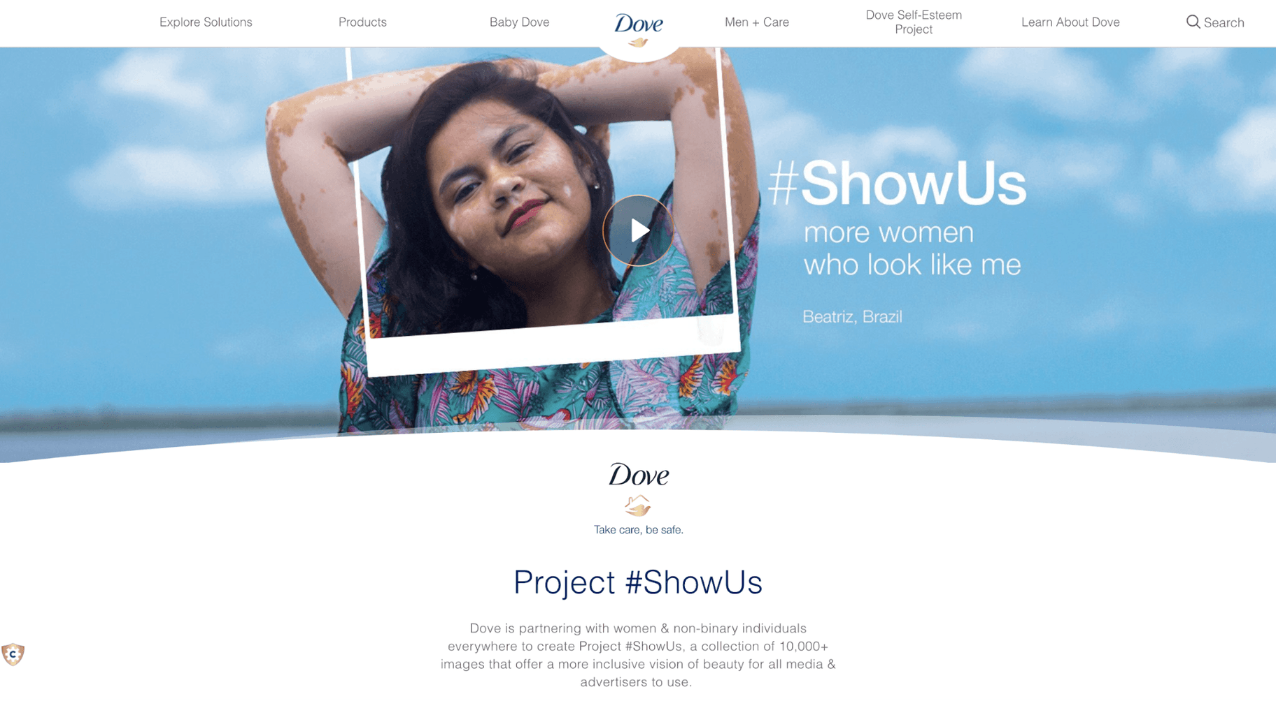
Social media – positive uses

Slide 7
Benefits of social media
Keeping in touch with your existing friends
Making new friends
Join social groups of people with a common interest
Join professional groups of people with a common interest
Campaigning
Sharing information, images or videos
Collaboration or projects
Commercial marketing, advertising
Notes:
Activity
In groups or own your own write down what you believe the benefits of social media to be

Slide 8
How does social media make you feel?
Fear of missing out
Isolated
Stressed
Lonely
Envy
Loss of reality
Anxious
Low self -esteem
Addiction
Depression
Negative
Angry
Notes:
ACTIVITY
Get people to say how they feel using social media. Frightened, Confused, Exasperated, Confident
Ask who uses it and in what way?
Social media (networking) sites are websites and apps that allow people to connect with others who have similar interests. Users share information, thoughts, ideas and images and connect with family, friends, work colleagues or like-minded people. Some sites such as Facebook, Twitter, Google+ and LinkedIn are based around making connections with people that you may know. Others such as Instagram, Flickr and YouTube are based around sharing images and video, whilst others like Blogger or Tumblr are about sharing a web log or online diary (blogging).
Do you think you use social media too much? Does that little red notification bubble give you anxiety, or do you feel yourself itching to check it….?

Slide 9
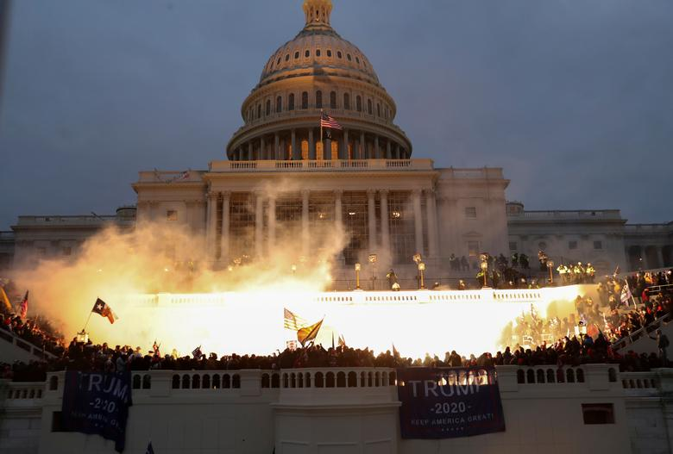
Disadvantages of social media
What you post online does not go away!
Cyberbullying
Hacking
Abuse
Incite hatred
www.bbc.co.uk/news/entertainment-arts-51542688
Notes:
Activity
Now in your groups or on your own write down what the disadvantages are of social media
Cyberbullying
Hacking
Social media causes death – not just by using it, but by following the stunts and other crazy stuffs that are shared on the internet. For example bikers doing the unnecessary stunts, people doing the jump over the trains and other life threatening stuffs. For example in this video 14 year old from mumbai was doing stunts on a running train which caused his death. These types of stunts are performed by the teenagers because of the successful stunts made and shared over the social media. Like the tide pod challenge a couple years ago
Addiction
Security issues
Lack of inhibition
Threat to those living in witness protection or escaping abuse
Stealing someone's identity or personal information
Bullying and harassment
Inciting hatred and/or discrimination
Encouraging others to do harm to themselves

Slide 10
Social media and work
In 2016 CNBC reported that 28% of all those employed have either been fired or faced disciplinary action due to their activity on social media.
The BBC in 2014 reported that one in ten job seekers between the ages of 16 and 34 have been rejected for a job because of something posted on their social media profiles.
Notes:
While there are clear advantages and disadvantages to using social media, the main cause of our concern is often what members post about their work online. There is a direct link between your personal and professional life.
More often than not our digital footprint is now seen as a mirror into our personalities and in fact can leave more of an impression than your CV. People reveal more than they think they do on social media, and what we choose to share may be seen by our future employers
https://www.inc.com/marcel-schwantes/a-new-study-reveals-social-medias-impact-on-hiring-firing-of-employees.html
We will look at a few real life scenarios over the next couple slides.

Slide 11
Case study one
Midwife A complains on Facebook that a woman she looked after during her previous shift was “so overweight it’s a wonder the bed didn’t collapse”. She then goes on to say "Why do we have to look after fat birds?“ Midwife B comments "I know exactly what you mean. Makes our job even harder!
Outcome: In this case both midwives were taken through disciplinary procedures and dismissed for bringing the employer into disrepute

Slide 12
Case study two
A group of midwives were chatting on Facebook messenger. They all joined in a conversation complaining about where they work. They felt they were in a safe environment as they had set up a closed group for themselves; however someone outside their immediate circle had requested access to the group which had been granted by the group administrator. This person took screen shots of the comments, printed them out and put them under the Head of Midwifery’s door.
Outcome: All midwives involved were disciplined and all received a final written warning. The two band 7s involved in this case were down-banded.

Slide 13
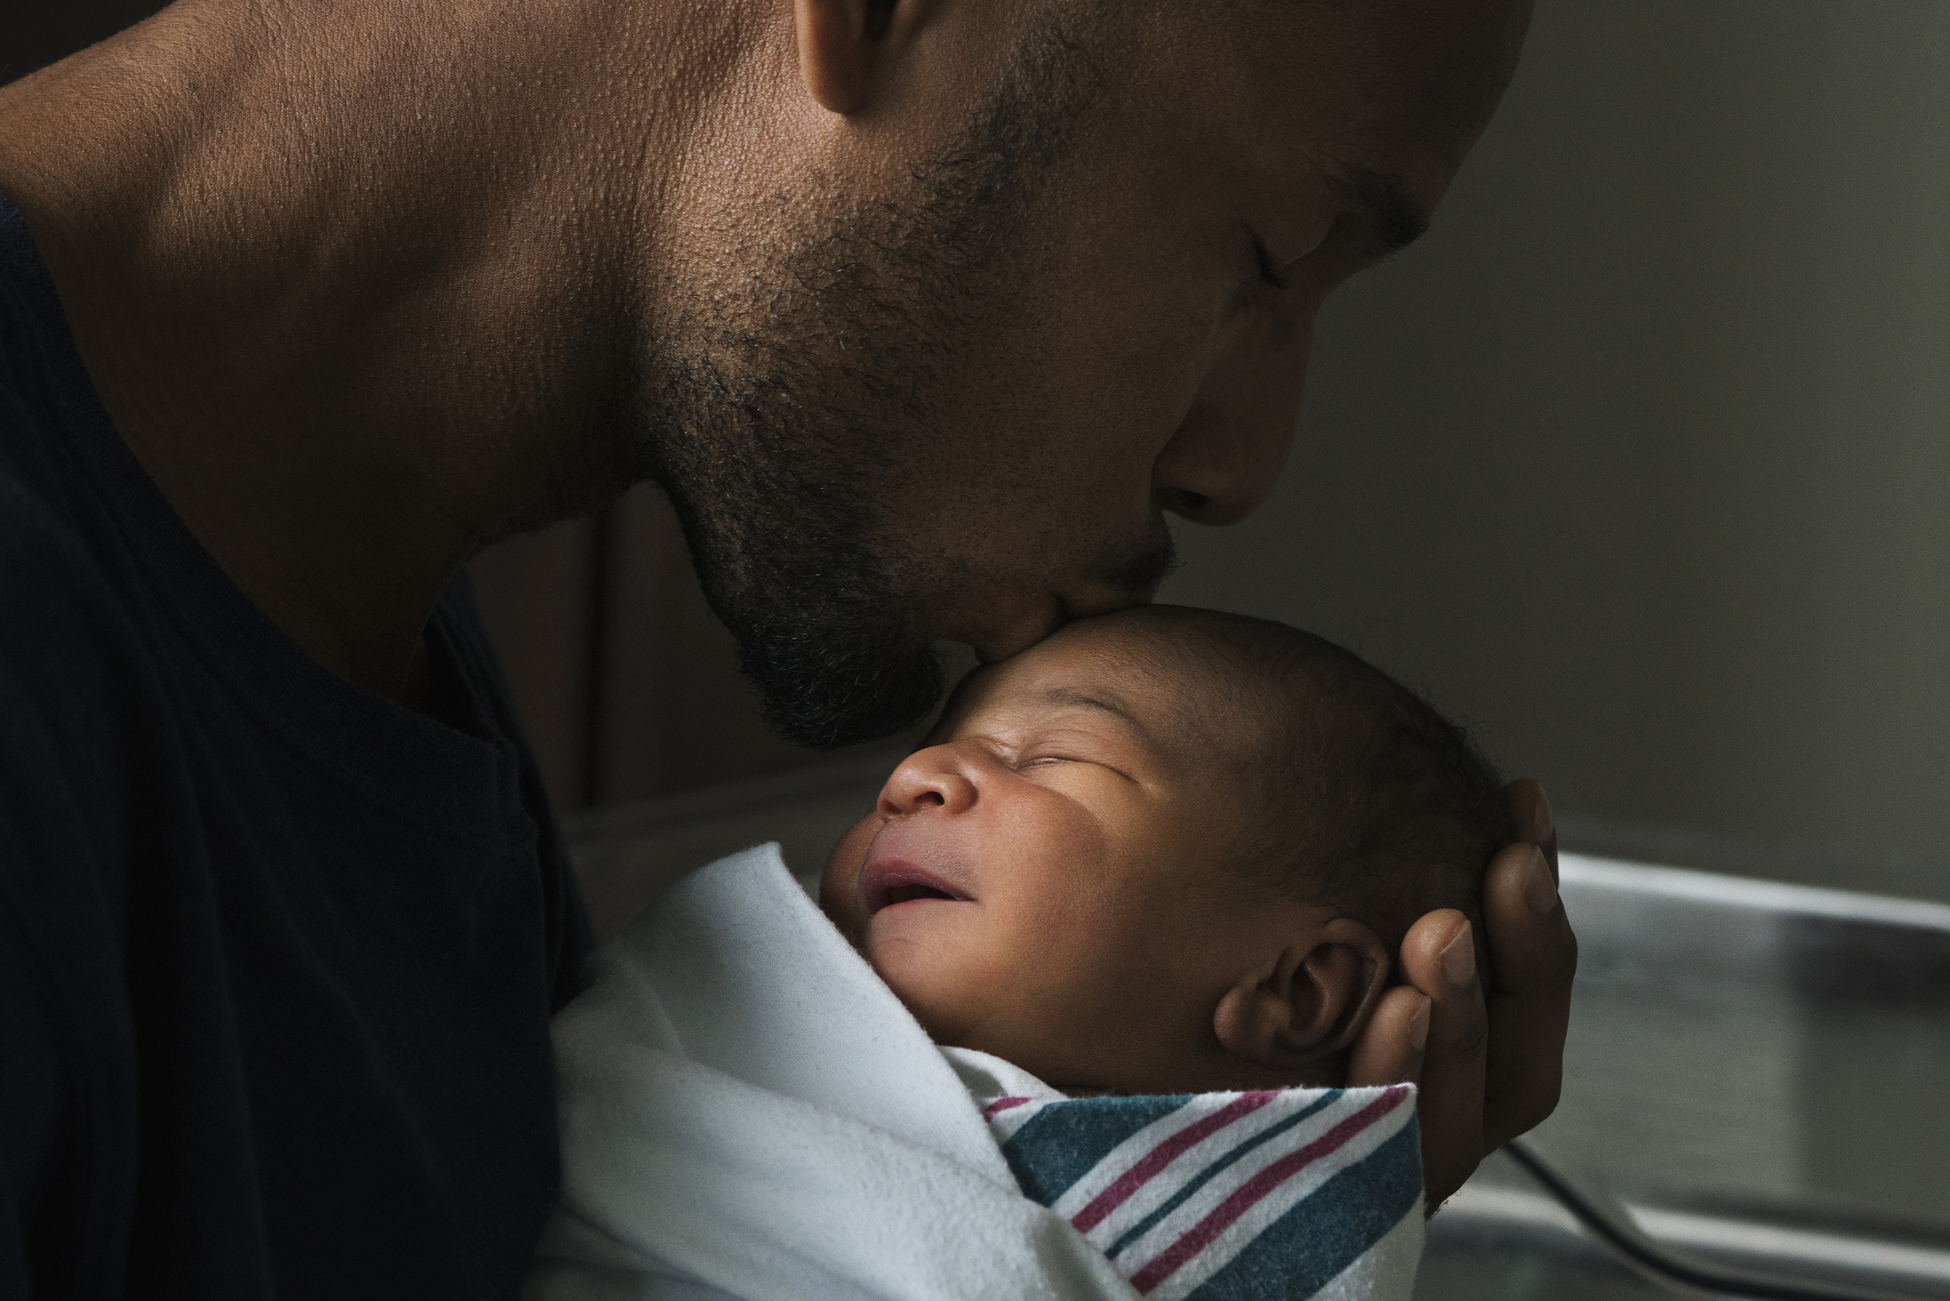
Case study three
Mr X Celebrity had a baby at our hospital this weekend
Here is a photo of Mr X Celebrity and baby!!!
Outcome: internal disciplinary action. Let off with a warning.
Notes:
This did actually happen, and the midwife got disciplined
Celebrity not unduly concerned – all publicity = good publicity

Slide 14
Case study four
No longer works for the Trust
Notes:
She no longer works for the Trust, allowed to resign.
I don’t know what happened to the person who took the photo.

Slide 15
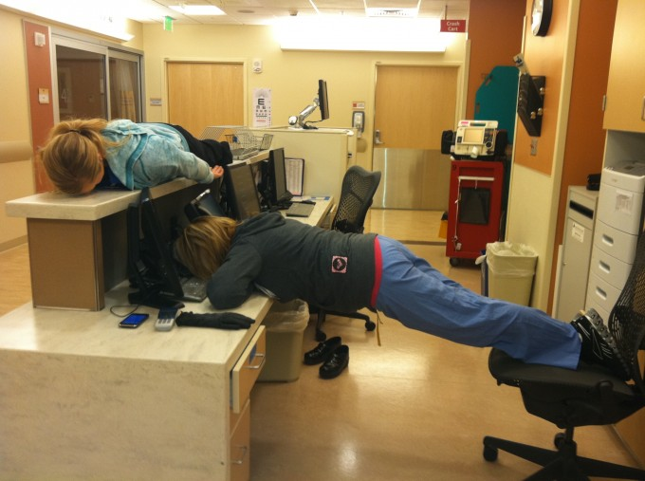
Case study five
All three suspended and given written warnings
Notes:
Ever heard of ‘planking’?
Staff larking around and the photo got re-sent among colleagues and sent to manager.
Suspended, disciplined but didn’t lose their jobs. Very traumatic and upsetting experience

Slide 16
Suitable to share online?
Busy shift, couldn’t get away on time at the end of it, why is it always so difficult…..
Look out night shift on Labour Ward, understaffed AGAIN! You girls are going to be sooo busy…..
https://metro.co.uk/2020/04/23/killjoys-want-nhs-staff-stop-morale-boosting-tiktok-dances-12597107/
Notes:
Ask if these are suitable – the first may seem fine, the choice of words ‘busy shift’ and ‘difficult’ seem just a personal comment on a days work but lots of things may have occurred on that shift (in this case a neonatal death) and although this person was not involved in that care it was seen to bring the Trust/Board into disrepute. It could also cause unduly upset to the parents and family of the NND if they saw this.
What if a pregnant woman got to see the second post? ‘Labour Ward understaffed’ comment may cause worries, concerns, anxiety etc.
Link takes to an article, discussing NHS tik toks videos during covid, but comments on public perceptions, of wasting PPE and not appropriate for family members to see when family members are ill and/or dying with covid, etc.
Be careful posting photos too that contain people in the background. Even if you have the permission of the people in the foreground you need everyone’s permission to post this. How do you know that you are not breeching someone's safety by posting this, they could be fleeing violence or have other reasons for not wanting their photo shared.

Slide 17
Requests from women and their partners
What do you do if asked to ‘be my Facebook friend’ or ‘Follow me on Instagram’?
How do you respond to requests for photographs?
Notes:
Start group discussion
Facebook and Instagram – suggest the members politely decline – ‘breaks Board/Trust and NMC guidelines’ is a good get-out.
Interactions can be shared with anyone, may breach patient confidentiality
Photographs – you have the right to decline to be photographed. You have no idea how or where the pictures will be used.
Discussion – it can be hard to decline an invitation to be photographed, especially if the member of staff has built up a great rapport with the woman.

Slide 18
What your employer might say?
Bring the organisation into disrepute
Breach confidentiality
Breach copyright
Do anything that could be considered discriminatory against, or bullying or harassment of, any individual
What is your employers guide on social media?
Usually found on staff intranet, sometimes asked to sign a paper copy annually and record they’ve read and understood the policy
Do you know where to ask if you can’t find it?
Notes:
Bringing the organisation into disrepute.
criticising or arguing with customers, colleagues or rivals, making defamatory comments about individuals or other organisations or groups, posting images that are inappropriate or links to inappropriate content
Breach confidentiality
revealing trade secrets or information owned by the organisation giving away confidential information about an individual (such as a colleague or customer contact) or organisation (such as a rival business) discussing the organisation's internal workings (such as deals that it is doing or future business plans that have not been communicated to the public).
Breach copywrite
using someone else's images or written content without permission, failing to give acknowledgement where permission has been given to reproduce something
Do anything that could be considered discriminatory against, or bullying or harassment of, any individual
making offensive or derogatory comments relating to sex, gender reassignment, race (including nationality), disability, sexual orientation, religion or belief or age, using social media to bully another individual (such as an employee of the organisation), posting images that are discriminatory or offensive [or links to such content]

Slide 19
NMC Code & social media
The Code, paragraph 20.10 specifically relates to the use of social media
“Nurses and midwives may put their registration at risk, and students may jeopardise their ability to join our register, if they act in any way that is unprofessional or unlawful on social media including (but not limited to):
Sharing confidential information inappropriately;
Posting pictures of patients and people receiving care without their consent;
Posting inappropriate comments about patients”
www.nmc.org.uk/standards/guidance/social-media-guidance
Notes:
Emphasise Midwives can put their registration ( and therefore their jobs and livelihood) at risk. Students too can jeopardise their chances over ever getting on the register
The guidance around the use of social media was updated in the 2015 version of the code.
“Use all forms of spoken, written and digital communication
(including social media and networking sites) responsibly.”
(The Code, paragraph 20.10)
Nurses, midwives and nursing associates may put their registration at risk, and students may jeopardise their ability to join our register, if they act in any way that is unprofessional or unlawful on social media including (but not limited to):
• sharing confidential information inappropriately;
• posting pictures of patients and people receiving care without their consent;
• posting inappropriate comments about patients;
• bullying, intimidating or exploiting people;
• building or pursuing relationships with patients or service users;
• stealing personal information or using someone else’s identity;
• encouraging violence or self-harm; and
• inciting hatred or discrimination.
If you are aware that another nurse, midwife or nursing
associate has used social media in any of these ways, it might be
helpful to refer to our guidance on raising concerns (NMC, 2013).
This sets out your professional duty to report any concerns you
have about the safety of people in your care or the public, and
the steps you should take to do this.

Slide 20
The NMC – recognises the benefits of social media
If used responsibly and appropriately, social networking platforms can offer several benefits for midwives, MSWs and students. These include:
Building and maintaining professional relationships; this includes with colleagues and women and their families, high use of WhatsApp and/or Facetime during COVID-19, set to continue.
Establishing or accessing nursing and midwifery support networks
Being able to discuss specific issues, interests, research and clinical experiences with other healthcare professionals globally; and
Being able to access resources for continuing professional development (CPD)
Notes:
NMC Guidance (March 2015) states that they promote the beneficial aspects of Social Media.

Slide 21
Think safety
Check your social media privacy settings, make everything as private as it can be.
Have a social media clear out, unfriend, unfollow and turn off notifications for groups you are no longer interested in or people you no longer wish to stay in touch with.
Ensure everything you post, share, like you would be happy to defend in a court of law.
Encourage friends and family to also secure their accounts, makes it harder for ‘outsiders’ to see your information
Never ever post private, confidential or personal information online, including phone numbers
Complete the social media i-learn course (counts toward your CPD!!)
Adhere to NMC guidelines
Familiarise yourself with and follow local NHS guidelines

