Slide 1
Embedding a safe working culture in aviation and parallels with maternity health care
RCM Think Tank, Edinburgh, 16 Nov 23
Cass McNamara, Midwife & CEO Birthsparks
Steve McNamara, Air Traffic Controller, NATS
Notes:
Introductions –
Why everyone is here
What they hope to get from the sessions

Slide 2
Objectives
To introduce you to the world of NATS and UK air traffic through a midwife’s eyes!
To explore similarities and differences between air traffic control and maternity care
To understand NATS’ Just Culture principles
To understand how NATS tries to embed this holistically.

Slide 3
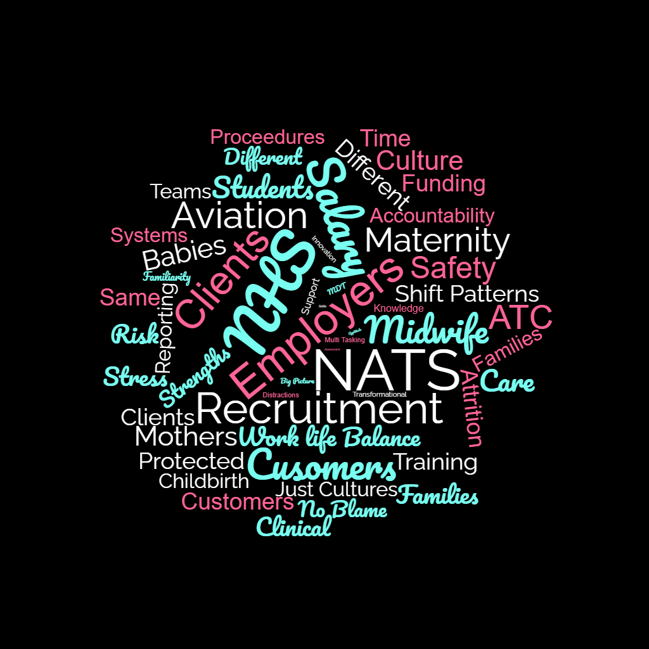
Notes:
Intro RE:Cass & Steve
Context
Presentation
Introduction - ‘ I have always wondered why NHS doesn’t listen to how aviation treats their workforce as a key part of safety. We know that there has been lots of work in NHS in term so Quality improvement and safety that all learns from aviation, but have we listened to the key part which is how we work with the people providing care or in aviation keeping flights safe’.
A focus on how folk are supported and the culture that is created.
Coming back from sick leave it is normal to be on with someone else this isn’t a weakness but a strength
Not working more that 6 hours without sleep
Something about being a good worker is not the one who ignores fatigue or hunger!-personal responsibility for human factors
How there is a learning culture
Focus on team work and developing teams
There is so much going on currently about culture but culture is this is how we do things it is not a wee addition but implementation for everyday practices that create the conditions for safety /psychological safety)

Slide 4
Comparisons
 | Maternity | Air Traffic
Numbers | 41,716 | 1652
Students | 9000+ | 60 annually
Training | 3+ years | 3+ years
Attrition | 15% | 2.5%
Retention | Low | High
Shift Patterns | Variable/Unpredictable | Fixed/Predictable
Salary | £26,000-£50000. Av £39,000 Bottom Band 5-top Band 7 | £42,000-£120,000 New Qual-Supervisor/Specialist
Clients/Customers | 800,000 Pregnancies/year 673,000 live births (2022) | 2.2 Million aeroplanes (220 Million customers)
Contact/Care type | 1-2-1 and section | Group (sector)
Notes:
Air Traffic/Maternity
Differences & Questions
Largest employer: NHS & NATs
Employees NATS
4227 (total)
1652 controllers
1176: others
780 Engineers
619 service assistants
Twice as many support roles for controllers than there are controllers
Q: what impact does high level support have on ATCs compared to midwives?
NMC Register: 41,716 midwives on the register in March 2023
20% in education, non-clinical roles, mat leave
= 33,374
2400 FTE in Scotland
Around 20 times more midwives than ATCs in the UK 20:1
Point: numbers are a poor indication of workload, but ATC also have a high workload? However, a Midwife can only provide labour care for one birthing woman (maybe 2) at one time, ATC can speak to multiple planes at once
Trainee recruitment
NATS: currently 60/per year.
Average 3000 applicants for every 20 places. (150 applicants for every 1 places)
2.5% attrition rate
MW: 9400 per year applicants, 4000 (1000 applications in Scotland) 2.4 applications for every place
15% attrition rate. Health Education England found that 58.3% of student midwives considered leaving their course in 2022.
6 times higher attrition rate for STMW (6:1)
The NHS only gains 1 midwife for every 30 trained due to poor retention, 157 times more midwives trained each year than ATCs (157:1)
Q: Why is ATC more desirable than MW? Why are attrition rates 6 times higher for MWs?
Retention MWS: poor, more than half (58%) have considered leaving (HEE) as NQM. Retention of NQM is poorest in first 5 years
Retention of ATC: very high (over 95%??) stay in the profession
Widening access
ATC apprenticeship (new). Academic reqs. Aptitude tests (like LNAT/GAMSAT), personal statement, Interview
MW apprenticeship (new). Academic reqs. Personal statement, Interview
Q: would an equivalent aptitude test improve attrition rates for midwives
Work environments
ATCs: Airports/airfields, National centres, Military bases, Specialist roles
MWs: Hospitals, Birth centres, Community, Specialist roles
Both have multiple roles and places of work
Teams
ATCs: Fixed watches include all levels of skill, students, admin etc. Distinct self supporting ‘service ecosystem’. Strategic planning/rostering on each shift
MWS: Variable not usually fixed (unless specific specialist team e.g homebirth)
Q: What are the potential benefits of fixed teams?
Shift patterns
ATCs: 2 early, 2 late, 2 nights, 4 off. More stability in predicting/planning around work for ATCs
MWs: Early. Late, night, 9-5, on calls, Variable patterns
Q: Would fixed shift patterns be easier for MWs to work?
Shift numbers per 24 hours
ATCs: Fixed at 3
MWs: Variable: E,L,N, 12 hour shifts, can be up to 4 different patterns on each unit
Workload
ATC: 2.2 million flights
(220 million passengers)
MWs: Approx: 800,000 per year.
(673k live births.
127k SA, TOP, SB)
Contact/Care episodes
ATC: 7530 per day.
314 per hour
2 centres PW + SW)
2500 per 8 hour shift
MWs: 2192 per day.
92 per hour
(UK whole)
736 per 8 hour shift
Point:*Numbers are a poor indication of labour intensive jobs.
Contact/care type
ATC: Group (sector). Up to
15 planes at one time
MWs: 1-2-1 (Hosp/BC/Community), Group-an/pn/clinic
Point: MWs don’t have a higher workload but they do have a more labour-intensive workload =more people required for lower outcomes:
1 woman or 15 planes? Different but not harder

Slide 5
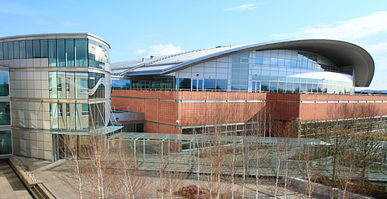
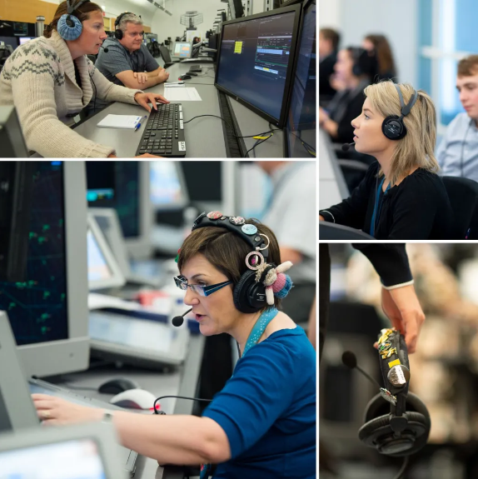
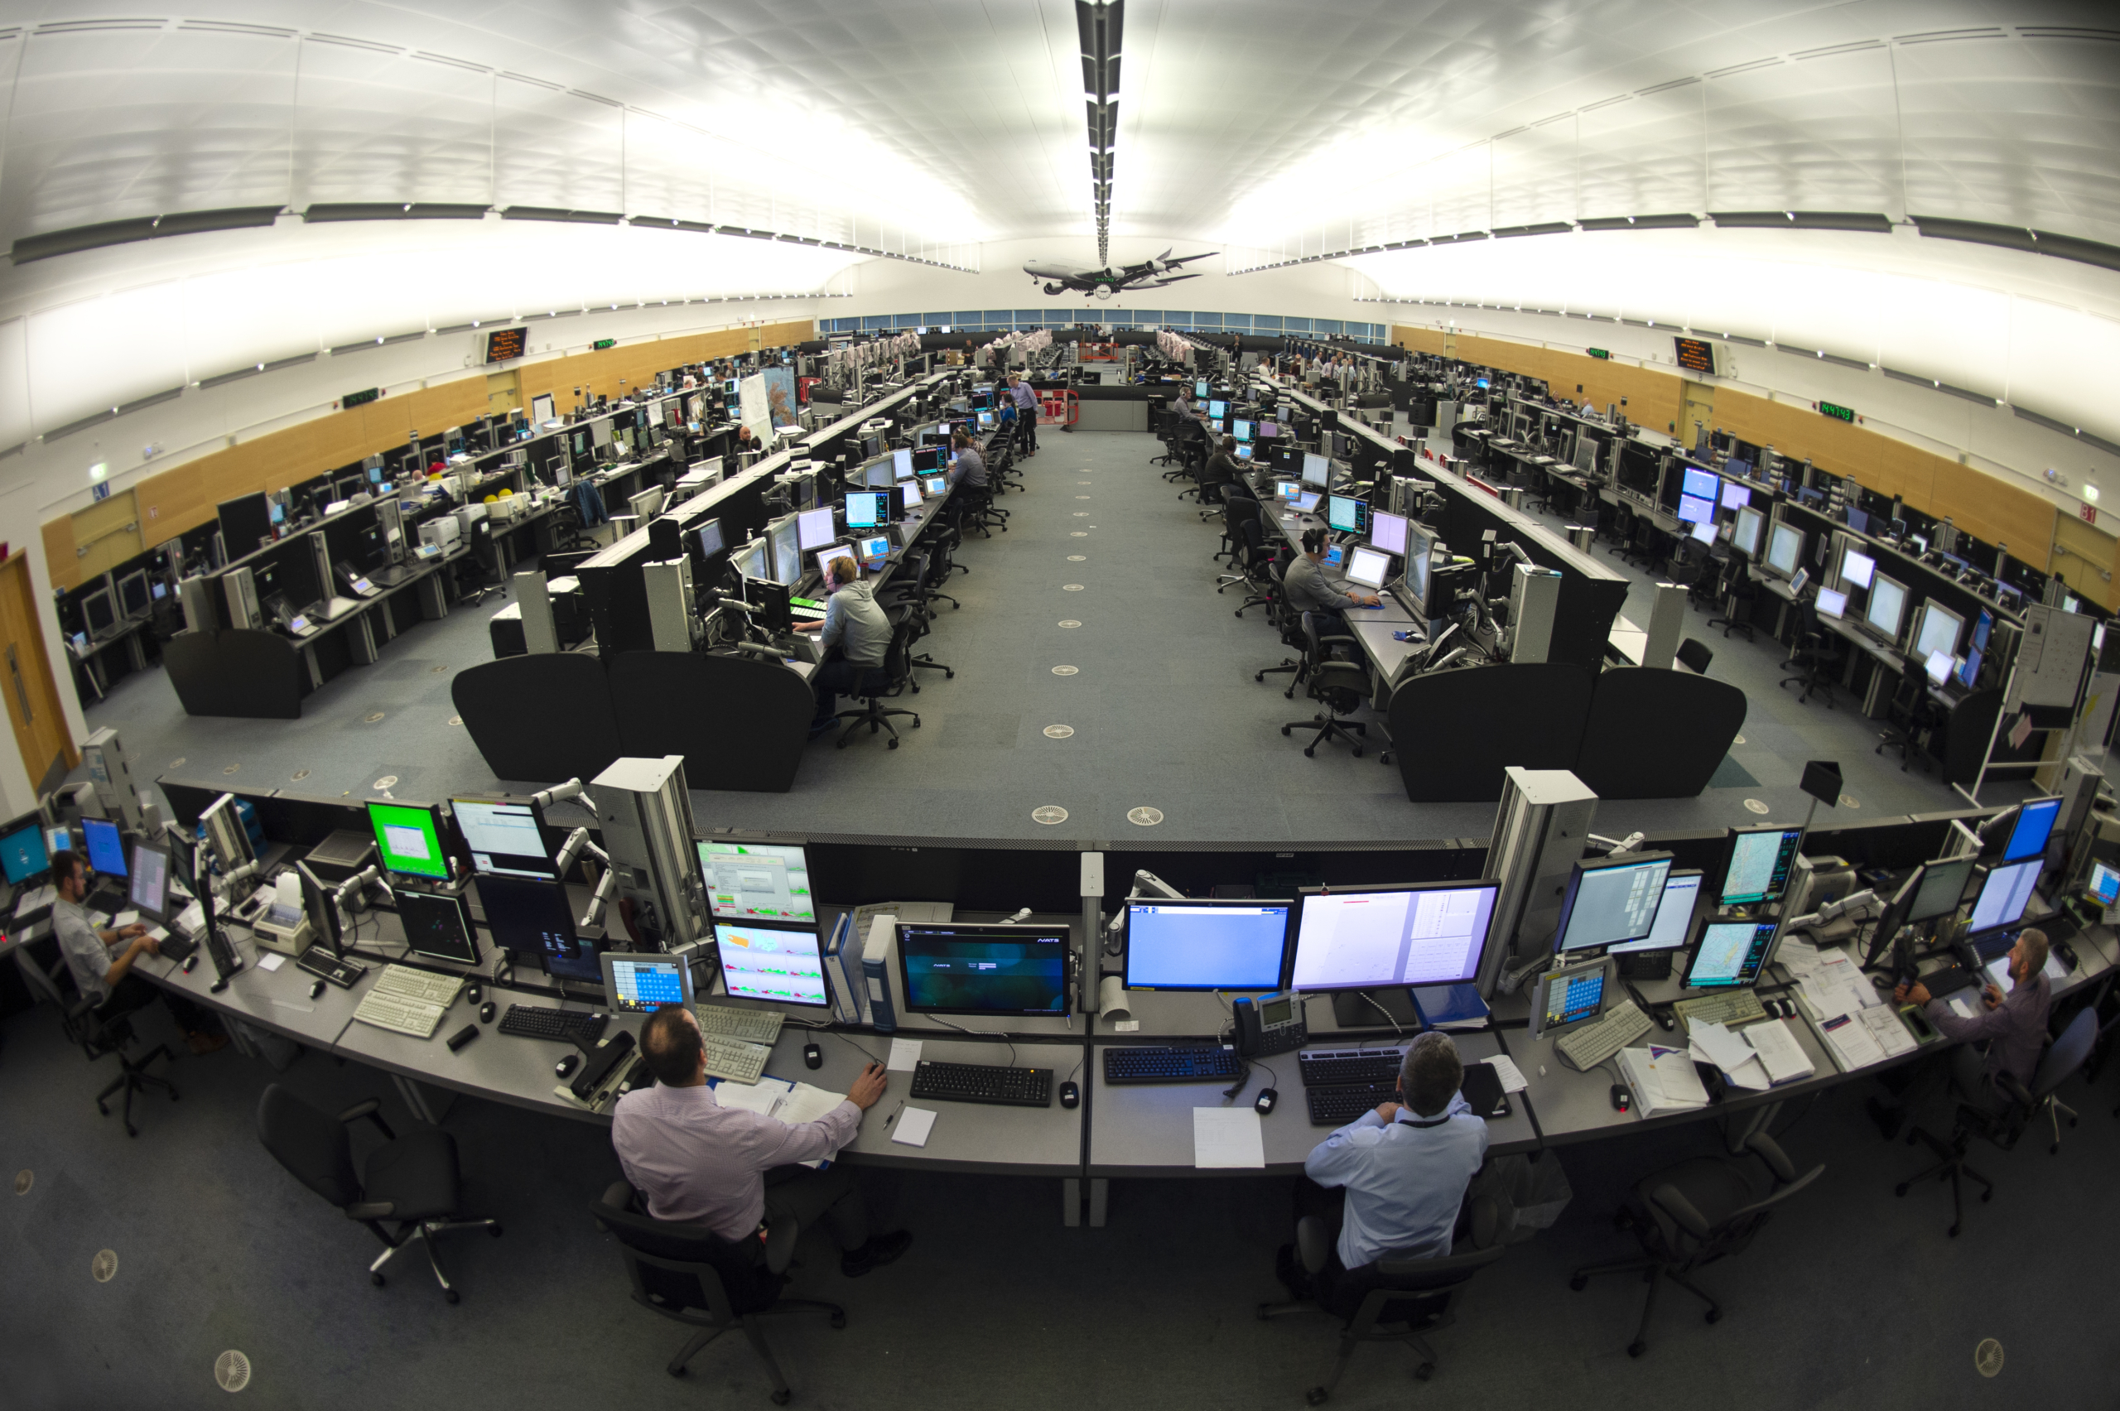
Steve’s role: Area Controller

Slide 6
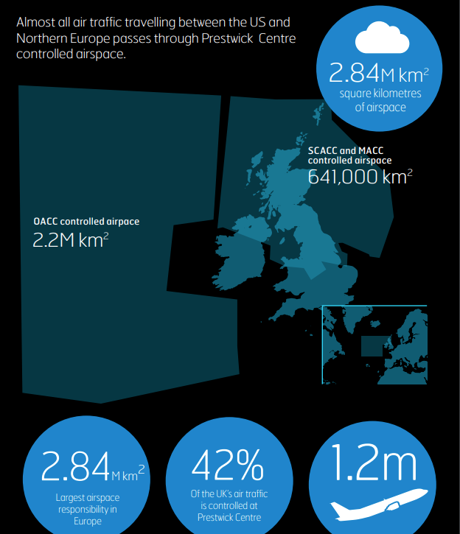
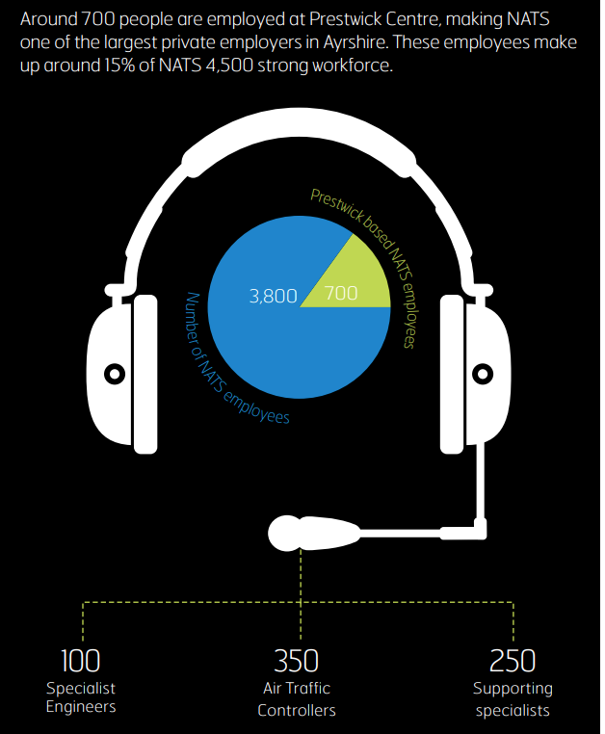
NATS Prestwick Centre

Slide 7
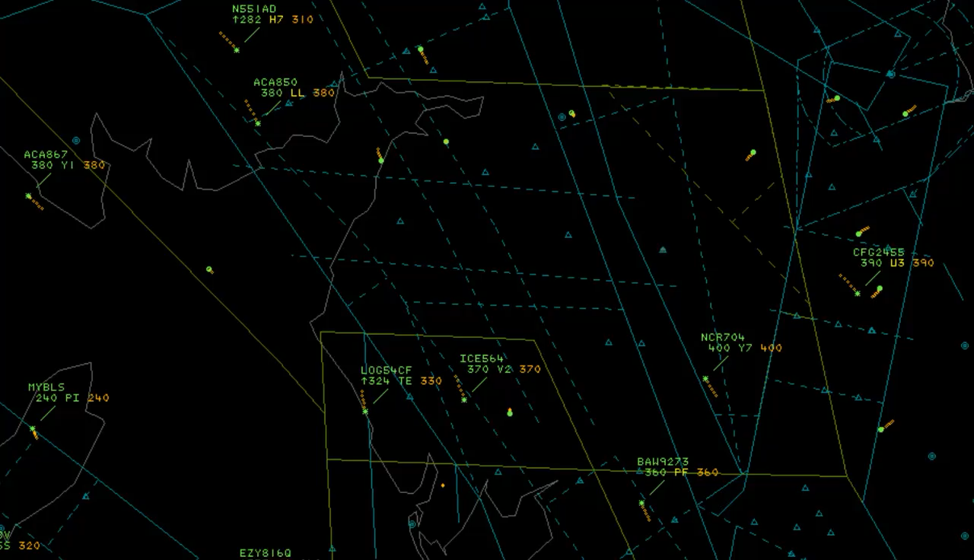
NATS Prestwick Centre: At Work

Slide 8
Just Culture
What is Just Culture?
Why does it matter whether a safety related organisation has one or not?
Structures for training, competence and safety
Empowering feedback at all levels
Supporting your team
Notes:
A Just Culture means that you should feel comfortable reporting something that hasn’t worked well even if you have made a mistake. It should give you confidence that whatever happens you will betreted fairly, justly and not blamed.

Slide 9
Just Culture: NATS definition
“A culture where staff are not punished for actions, omissions or decisions taken by them that are commensurate with their experience and training, but where gross negligence, wilful violations and destructive acts are not tolerated”.
Notes:
This is the NATS definition. Now used by Eurocontrol, CANSO and other organisations
It seems simple but putting the statement into practice is not as straightforward and appears to be misunderstood in many cases

Slide 10
Just Culture: background
SAFETY BEHAVIOUR
↑ Changes ↑
ATTITUDE TO SAFETY
↑ Changes ↑
PERCEPTION OF RISK
↑ Changes ↑
LEARNING
↑ Leads to ↑
OPEN REPORTING
↑Leads to↑
JUST CULTURE
Notes:
This diagram illustrates the fact the Just Culture is the foundation of the kind of Safety Culture that we wish to build.
With Just Culture at the foundation we build a good reporting culture, and develop effective lesson learning.
This organisational culture in turn has an effect on the individual, changing perceptions, attitudes and behaviours.
Without Just Culture as the foundation stone, the rest of the structure is weak.

Slide 11
Just Culture: NATS principles
Just Culture leads to Open Reporting
Risks are openly and honestly discussed
Just Culture applies specifically to the operational domain and the delivery of a safe service
Just Culture is about balancing safety and accountability
Just Culture is about learning safety lessons
A Just Culture is not a ‘No Blame’ Culture. There is a line between acceptable and unacceptable safety behaviours
Where the line gets drawn is determined by those in the operation
If someone reports an event which may implicate themselves we will treat them justly
Notes:
In order to ensure that a Just Culture exists within NATS, we adhere to a set of Just Culture Principles. Details of principles on a separate sheet.

Slide 12
Just Culture: embedding
Training our new controllers
Looking after our team: on-going management of professional competence
Our shift patterns: the watch-based team and patterns of working to avoid fatigue
Supported Returns to work
Post Incident Actions: Investigation, Recovery & Peer support
CPD: Learning as we go.
Notes:
A focus on how folk are supported and the culture that is created.
Coming back from sick leave it is normal to be on with someone else this isn’t a weakness but a strength
Not working more that 6 hours without sleep
Something about being a good worker is not the one who ignores fatigue or hunger!
How there is a learning culture
Focus on team work and developing teams
There is so much going on currently about culture but culture is this is how we do things it is not a wee addition but implementation for everyday practices that create the conditions for safety /psychological safety)

Slide 13
Just Culture
Questions/Discussion
www.nats.aero
steve.mcnamara@nats.co.uk
Notes:
Questions, wrap up and handouts to be given.

