Slide 1
From Charter to Culture: Implementing an Emotional Intelligence Programme
Nicola MacKay¹: Consultant Midwife, NHS Grampian
Dr Mo Tabib²: Midwifery educator & researcher, Robert Gordon University
Amanda Gotch¹ : Consultant Midwife, NHS Grampian

Slide 3
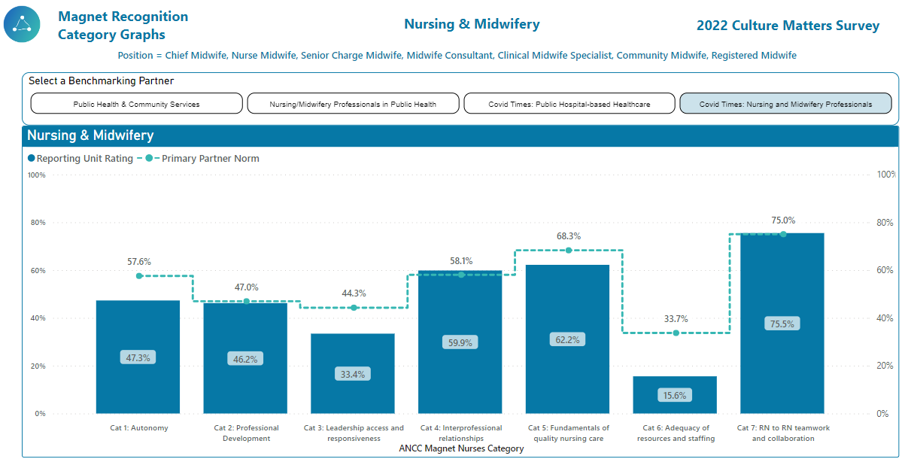

Slide 4
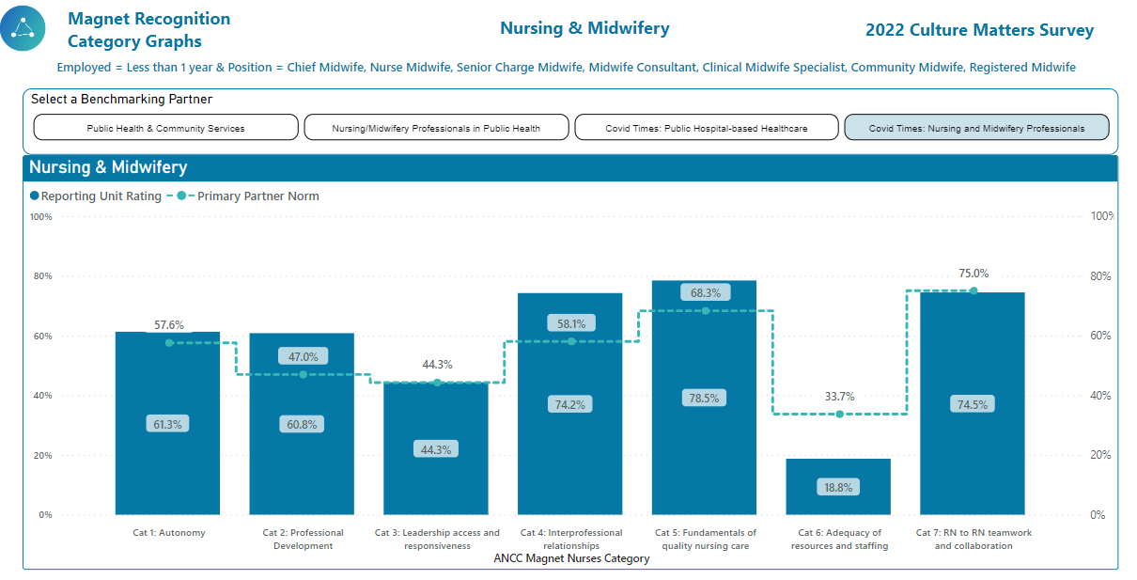

Slide 5
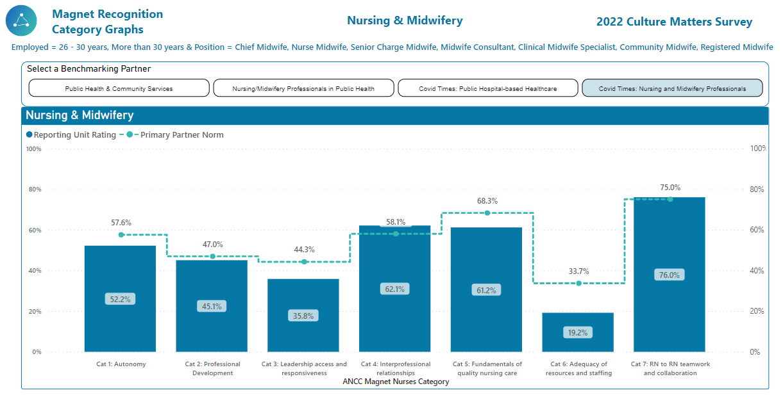

Slide 6
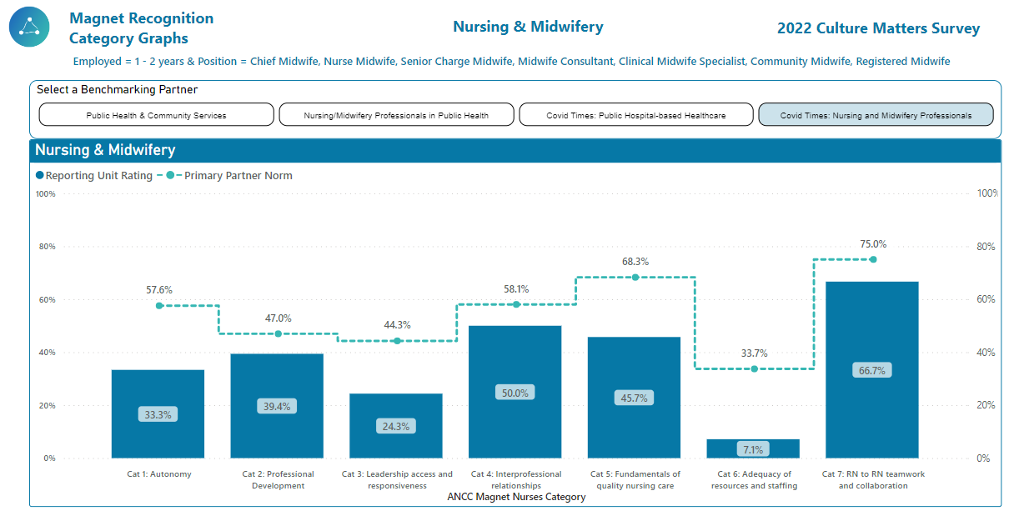

Slide 7
Respect
Consent
Communication
Fairness
Care
Honesty
Feedback
Notes:
We’d like to share with you our NHS Grampian Maternity Charter of Rights and Responsibilities, which was launched in August this year, the QR code on the screen will take you to the full charter.
The Charter was developed with members of the Grampian Maternity Voices Partnership and LATNEM (Let’s All Talk North East Mums). It draws on The Charter of Patient Rights and Responsibilities and lays out what women and pregnant people can expect from NHS Grampian when using Maternity Services and the expectations of them as a service user.

Slide 8
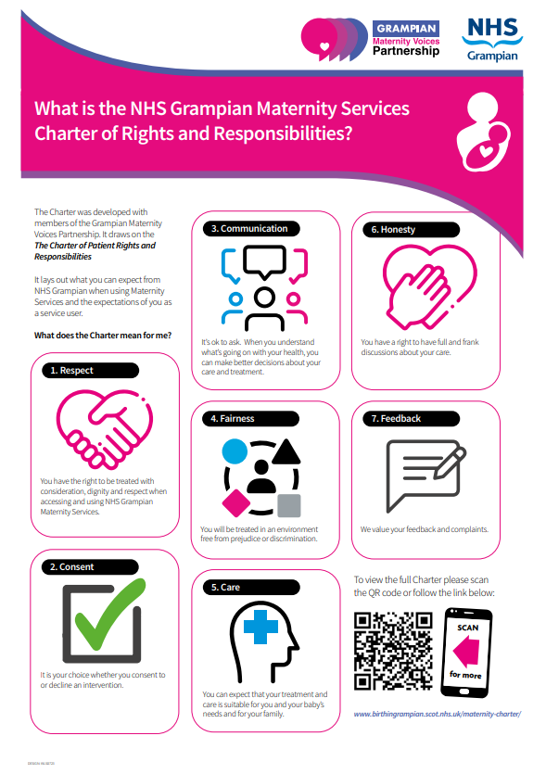
Notes:
What we have also recognised, is that this charter is our compass to navigate us to a place where we foster a respectful and reciprocal relationship with those we provide care to and those we work with. The 7 elements of The Charter are completely applicable to creating a culture where we have these shared values, ethics and beliefs in our day-to-day work. Our goal is that this will develop into an environment where colleagues feel valued, safe and have the opportunity for growth. We want, in simple terms, our colleagues to be the best version of themselves at their work.

Slide 9
Notes:
To demonstrate this, for the purposes of this presentation, we have very slightly edited the words in 4 elements of the charter.
Respect - Everyone has the right to be treated with consideration, dignity and respect when accessing, using and working in NHS Grampian Maternity Services.
It is the woman’s choice whether they consent to or decline an intervention.
Communication - It’s ok to ask. Realistic Medicine shows us that when people understand what’s going on with their health, they can make better decisions about their care and treatment. This also goes for encouraging colleagues to ask questions, to be professionally curious, if something doesn't feel right, there's a chance it's not.
Fairness - Everyone will be treated (including working in) an environment free from prejudice or discrimination. There is ongoing work to promote fairness at work within the board with our Culture Collaborative and last month we held our first diversity festival and launched our anti-racism plan.
Everyone can expect that their treatment and care is suitable for them and their baby’s needs and for their family.
Everyone has a right to have full and frank discussions about their care. Link to full and frank decisions with colleagues when required.
We value all feedback and complaints – we learn so much from the feedback we receive, from those we provide care to and those we work with. Feedback helps us to improve our practice or, do more of what we do well! We want colleagues to be open to providing constructive and professional feedback to each other, and to receive this proactively.
So how will be practically support our colleagues to embody The Charter and use this as their compass…over to Mo

Slide 10
What
How

Slide 11
Emotional Intelligence⁶ (EI)
Self-awareness
Managing one’s own emotions
Aware of others’ emotions
Building relationships
High EI is positively linked to wellbeing⁷ and has an inverse relationship with stress^{8,9}, emotional exhaustion¹⁰ and burnout¹¹ in health professionals.

Slide 12
Development of an Emotional Intelligent Programme (EIP)

Slide 13
The STEB programme (Situation- Thoughts- Emotions- Behaviors)
Thoughts
Emotions
Situation
Reaction

Slide 14
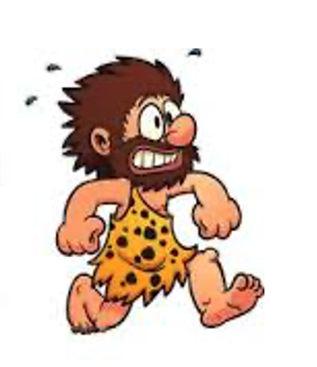
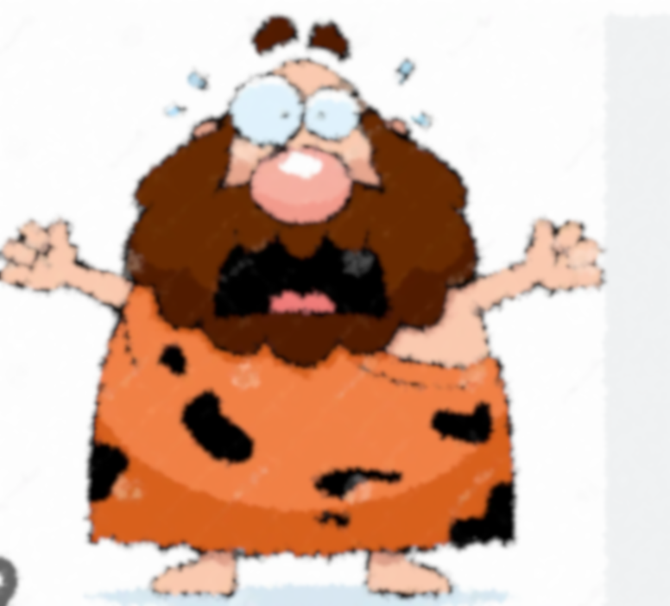
The STEB programme
Fight or flight
I’m going to get hurt/killed.
FEAR

Slide 15
Our behavior is the consequence of our physiology
Physiology (fight/flight response)

Slide 16
Shift in the physiology can enhance self-awareness
Conscious response

Slide 17
Emotional Intelligence Programme
Ability to shift the physiology (Relaxation practices)
Recognition of STEB in self

Slide 18
EI Programme
A 4-month programme delivered over six group sessions (total 24 hours)
A combination of in person and online sessions
Theoretical learning
Relaxation practices for self and others
Case-based learning
Practice-based learning

Slide 19
A mixed-method research study
Qualitative: Focus group interviews
Quantitative: Pre and post-programme surveys

Slide 20
Yeah, just (developed) a greater self-awareness …
It’s made me a calmer person, has helped me change as a person, to see things differently, not overthink as much, and just take a breath and calm down.
Relaxation practices
Recognition of STEB in self
She was having late decelerations and so, … my on-call midwife was 45 minutes away. So, it was that initial panic. But then taking that step back and I've never experienced anything like that before, it was a really strong feeling where I felt like I was almost out with my body looking at the situation and just telling myself, alright, this is what you need to do, and this is the order you need to do it in.
Self-awareness
Because you can relax yourself, then, you're more open to taking more time for other people, taking on what they're saying … you’re more aware of how they feel.
It's just kind of given me that belief in my role and the power that we have as midwives.
Calm mind
… she had a long latent phase and said ‘I just don't want to go home. I'm too scared’. I said, ‘do you want to try some relaxation?’. I think doing that little relaxation with her made her more relaxed ... Then she did go home and came back four hours later fully dilated where she was only one centimetre when she went home. Yeah, it worked.
Conscious response
Empathy
Unskilled
Burn out
Relaxation practices
Skilled
Compassion
Care outcomes
Empowered & confident

Slide 21
EIP can improve
Midwives' emotional wellbeing
Quality of the provided care
Midwives' experience of practice

Slide 22
Going forward …
Notes:
Charter to EIP to a culture that fosters those values and is equipped to bring them to life
Going forward, we have meetings planned with our MVP colleagues to co-design how we will measure the impact of The Charter to both those receiving care and those providing it, we will soon be advertising for expressions of interest for the next cohort of midwives to undertake the EIP programme and as a senior team, we are making the choice to be intentional in practising compassionate leadership.

Slide 23
References
Dixon-Woods M. Learning from maternity service failures at East Kent Hospitals. bmj. 2022 Nov 18;379.
Knight M, Stanford S. Ockenden: another shocking review of maternity services. bmj. 2022 Apr 6;377.
CBE BK. The report of the Morecambe Bay investigation.
Hunter B, Fenwick J, Sidebotham M, Henley J. Midwives in the United Kingdom: Levels of burnout, depression, anxiety and stress and associated predictors. Midwifery. 2019 Dec 1;79:102526.
Renfrew MJ, Cheyne H, Craig J, Duff E, Dykes F, Hunter B, Lavender T, Page L, Ross-Davie M, Spiby H, Downe S. Sustaining quality midwifery care in a pandemic and beyond. Midwifery. 2020 Sep 1;88:102759.
Goleman D. Emotional intelligence. Bloomsbury Publishing; 2020 Dec 8.

Slide 24
References
Por J, Barriball L, Fitzpatrick J, Roberts J. Emotional intelligence: Its relationship to stress, coping, well-being and professional performance in nursing students. Nurse education today. 2011 Nov 1;31(8):855-60.
Montes-Berges B, Augusto JM. Exploring the relationship between perceived emotional intelligence, coping, social support and mental health in nursing students. Journal of psychiatric and mental health nursing. 2007 Apr;14(2):163-71.
Naidoo S. Emotional intelligence and perceived stress: scientific. South African Dental Journal. 2008 Apr 1;63(3):148-51.
Tavan A, Chehrzad M, Kazemnejad Leili E, Sedri N. Relationship between emotional intelligence and occupational exhaustion on nurses. Journal of Holistic Nursing And Midwifery. 2016 Jun 10;26(2):49-58.
Vlachou EM, Damigos D, Lyrakos G, Chanopoulos K, Kosmidis G, Karavis M. The relationship between burnout syndrome and emotional intelligence in healthcare professionals. Health Science Journal. 2016;10(5):1.

