Slide 1


Newly Qualified Midwife Framework: from Transition as Student to Band 6 Midwife
Leanne Ritchie
for Alison Lowrie
Practice Education Facilitator (PEF)
16th November 2023
Notes:
I’m a Midwife who has worked in NHS Fife since qualifying over 27 years ago and I have been a PEF covering maternity, child and adult areas for over 15 years.

Slide 2

Objective
To develop a Newly Qualified Midwife (NQM) Framework to clarify the inter-linked process, requirements and support available from transition to Band 6
  NQMs in NHS Fife are employed as Band 5. Following a minimum of 12 months in post, clinical experience and completion of national Flying Start programme there is progression to Band 6
Notes:
An open and transparent framework that will create equity and security
NHS Fife have a Protected Learning Time document that links Flying Start completion with progression to B6.

Slide 3

Why?
Recognised a NQM perceived lack of clarity on how to progress from Band 5 to Band 6
Desire to support and invest in NQMs
Develop a person-centred resource to aid in valuing and retaining NQMs
Sustainable model required across Managers, Educator, PEF and Midwives
Notes:
Followed the Plan/ Do/ Study/ Act model - PDSA
PLAN: Allow person centred process and NQM to feel valued
Something I’ve considered for quite a while as it fits so well with my roles as both PEF and Clinical Midwifery Supervisor and recognised a perceived lack of structure for NQMs
Sustainable model required across Managers, Educator, PEF and midwives
RAG – priorities and strategies supporting project are Quality Strategy – person centred, NES Preceptorship Framework, NES Midwifery Workforce and Education 2021 Review and the PEF Priorities – supporting NQN/M orientation, induction and development.
DO:
Stakeholders and data collection:
Questionnaire for NQMs developed incorporating Positive Inquiry and the Senses Framework
Discussions with midwives
Meetings with midwifery managers
Discussions with clinical supervisors

Slide 4
NQM Findings
Instructions on how this (Band 6) is possible, who to contact, what you need to achieve etc
I found the clinical supervision sessions I attended really helpful, in particular the sessions specifically for newly qualified practitioners
I found having a 'buddy'/someone assigned to me on the postnatal ward really helpful
Bit lost
More regular PDP one to one
All the support – that’s why I chose Fife
By detailing exactly what was compulsory (clinical skills)
Perhaps a little information pack for each area
Notes:
I met with all stakeholders and NQM feedback above - data and trends as expected – lack of clarity on progression, skills, rotations, boundaries
Framework developed to incorporate all the different aspects of practice for the NQM and ensured it met the national strategies as next slide.

Slide 5

Mapping to strategies & PEF Priorities
Supports professional registration
Recruitment and retention
Consistency in practice learning
Positive learning culture
Providing infrastructure and embedding resources
Acknowledges students as future colleagues
Maps to the newly released NES Midwifery Preceptorship Framework for Scotland
PEF Priorities: seamless transition; induction and orientation; supporting development of Midwifery Career and Education Framework
Notes:
Mapping the NMQ Framework to the SE Scotland Practice Based Learning Experience Strategy.
Quality Strategy – person centred, NES Preceptorship Framework, NES Midwifery Workforce and Education 2021 Review and the PEF Priorities – supporting NQN/M orientation, induction and development.
NES Midwifery Preceptorship Framework for Scotland was released Aug 23. NHSF are part of the early pathfinder group.

Slide 6
NHS Fife NQM Framework
Preceptorship is overarching as per the NMC, NES and RCM preceptorship guidance
Each NQM will have support from:
Named Senior Charge Midwife
Named Flying Start Facilitator
Named Preceptor: known as Buddy
Named Clinical Supervisor for first 2 years
Clinical Education Midwife
Support Hub Midwife
Midwifery PEF
Launched September 2021
Notes:
The next 4 slides show you the content of the Framework. It’s one double sided A4 sheet of paper and begins with guidance and who is available for support throughout the first year or so.
Midwife Nicola Hain has developed an innovative NQM Support Hub which complements the Framework as you’ll hear later.

Slide 7
NQM
Transition from Student
Induction
Rotation
Flying Start
Clinical Skills/ Consolidating Practice
Clinical Supervision
Progression to Band 6
SSSA and ongoing CPD
Notes:
NQM journey – begins at Transition as a student within our partner HEI – Napier Uni covering FS, C/S, Revalidation and Recruitment to NHS Fife in the first place.
Each aspect feeds into the others and equally important part of the journey

Slide 8
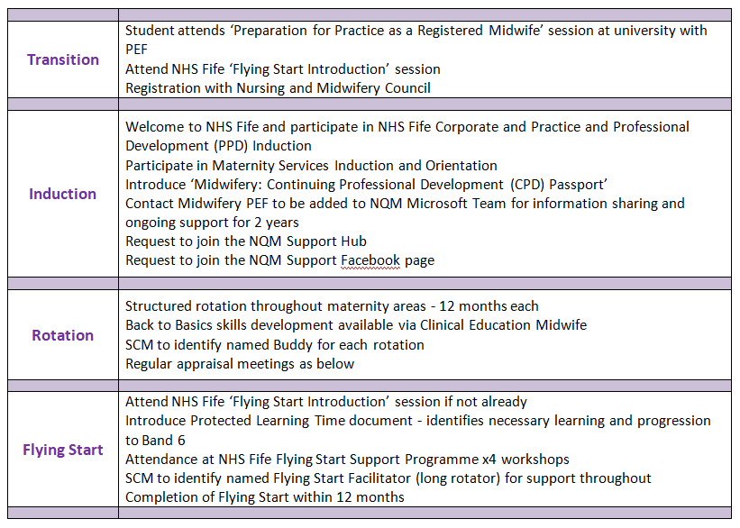

Slide 9
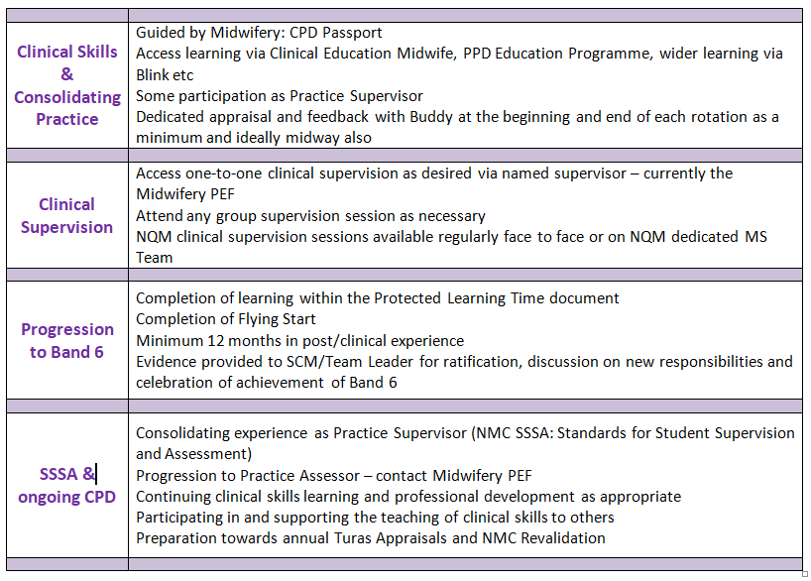

Slide 10
2021-23 Evaluation
Very clear and concise
Perhaps a focus on career progression and helping them see that there are many ‘different ways’ to be a midwife
Easy to Understand
Clarifies Process and Req’ts
Clarifies Support for NQMs
Offers Equity to NQMs
Supports experienced midwives with NQM Req’ts
Supports Orientation, Induction and CPD
I think as it’s embedded there may be additions or tweaks along the way
I think the framework is an excellent piece of work
Would suggest protected time with Senior Clinical Leaders
Notes:
As the Framework had been running for 2 years, I decided to undertake a small evaluation so you could hear what other people thought of the Framework. I also asked for suggestions on how it may be improved
21 responses – 12 MW (7 experienced and 5 NQM) and 9 Practice Education staff (6 from my own and 3 local PEFs) that I collaborate with.
Very positive feedback.
Further suggestions include meeting nurse managers and other NQs to support role development, career paths.

Slide 11
Impact & Influence
Shared with various NHS Fife midwifery and nursing leaders and groups
Presented at national events:
    Scottish PEF/CHEF Celebration Event
    NES Annual Virtual Conference
    SE Scotland Practice Learning event
    Best Start Learning and Sharing event
    Shortlisted for RCM Awards 2023
Requests to share as good practice:
    NHS Scotland Academy
    International Recruits
    RCM First Five Years Forum
Notes:
I’ve presented the Framework to many groups - inspiring and influencing others to develop their own versions of it.
Principles of Framework could be adopted across many professions/organisations making it very versatile
NES Midwifery Preceptorship Framework for Scotland with much of the same content was released in Aug 23 and NHS Fife are an early pathfinder board re the implementation of this.
Dates shared: PEF/CHEF Celebration Event 7th Sep 22, RCM First 5 Years Forum Aug 22, NHS Fife Leaders 10th Nov 22, RCM Awards shortlist panel 22nd March 2023, SE Scotland Practice Based Learning Experience Strategy event Forth Valley Hospital 17th April 23, NES Annual Virtual Conference 27th April 23, NHS Fife Workforce Group 16th May 23, 28th June Best Start Learning & Sharing event, 23rd Oct 23 Justine Craig CMidO in NHS Fife, 25th Oct 23 CMidO & NHS Board Leads meeting, 16th Nov RCM Think Tank event.

Slide 12
Conclusion
Person-centred NQM Framework embedded to ensure structures and processes in place for transparency and equity
Principles of Framework can be adopted across many organisations/professions
Informed, valued and supported newly qualified midwives in NHS Fife
Notes:
I’ve successfully met the objective of developing a Framework to guide and support NQMs in NHS Fife. This project has gone far beyond the support of NQMs in NHS Fife by sharing the Framework widely and highlighting how the principles can be adapted to suit multi-professions.
NHS Fife are investing in NQMs via the Framework and the Support Hub.

Slide 13

Thank you

