Slide 1
Women Centred Induction of Labour Experience
RCM Think Tank 16th November 2023
NHS Fife Maternity Services

Slide 2


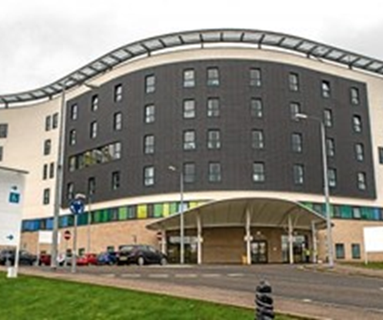

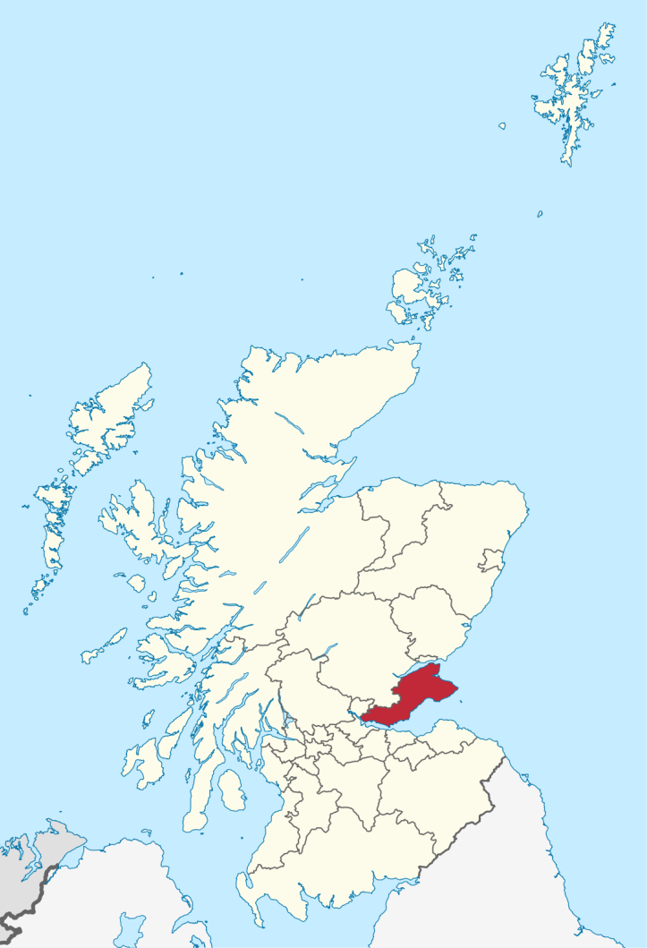

Slide 3

Induction of Labour
Rising rates
Impacting on daily flow
Leading to bottlenecks
Varying experience for women
Adverse events
Frustrations
Groundhog day
Reviewing and improving the pathway of care for women experiencing
IOL identified as a key local priority

Slide 4


Come with us on our improvement journey

Slide 5
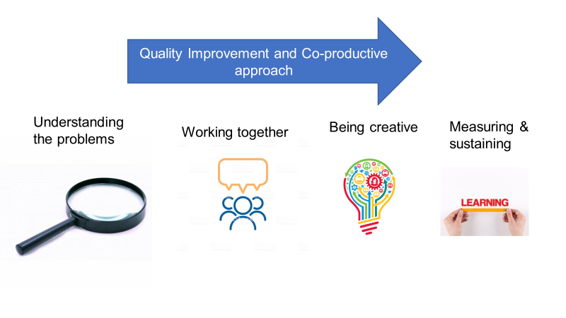

Slide 6

Understanding the system
Focus
Groups
Feedback from women
Process
Mapping
Ideas from the floor
Best practice elsewhere

Slide 7
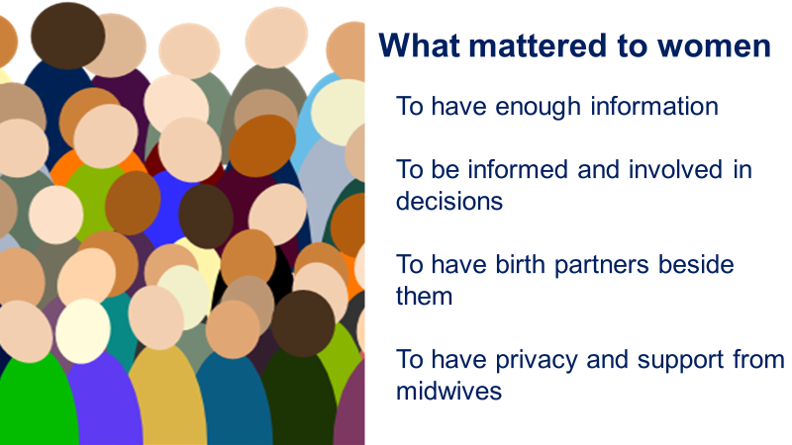

Slide 8
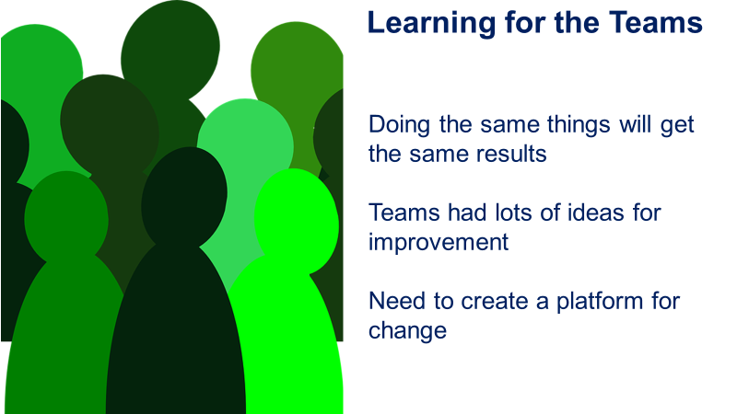

Slide 9
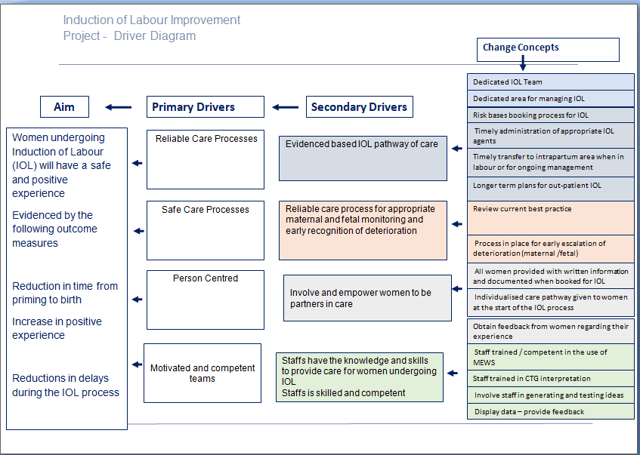

Slide 10

Informed and involved women
Support from companion
Caring and competent staff
Systems and processes
Home from Home Environment

Slide 11
Testing and implementing change
Option for birthing in AMU
A P S D
A P S D
Learning and Improvement
A P S D
Out patient IOL
Individualized care plans
A P S D
A P S D
Staggering appointments
Information for women
A P S D
Optimizing the environment
A P S D
Birth partners staying
Dedicated Team
IOL Suite – 4 rooms

Slide 12

Increase women’s satisfaction and
Overall positive experience
Improve women’s understanding of the of the induction process , risks and benefits
Reduce avoidable delays

Slide 13
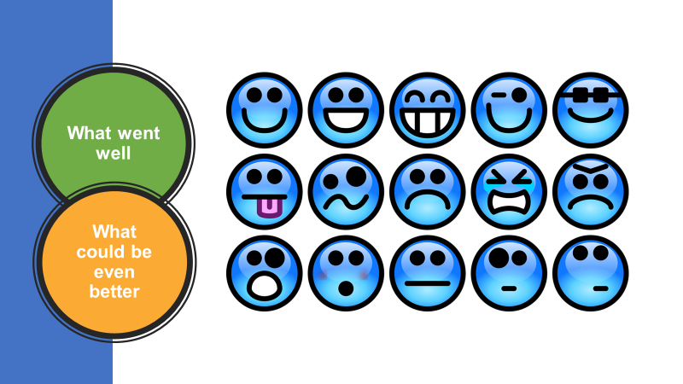

Slide 14

What has changed

Slide 15


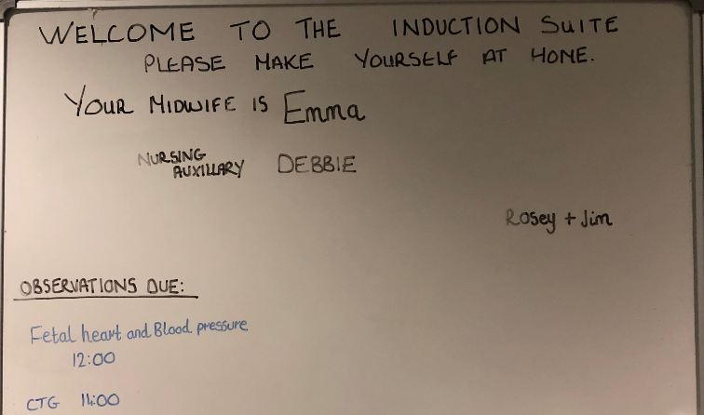
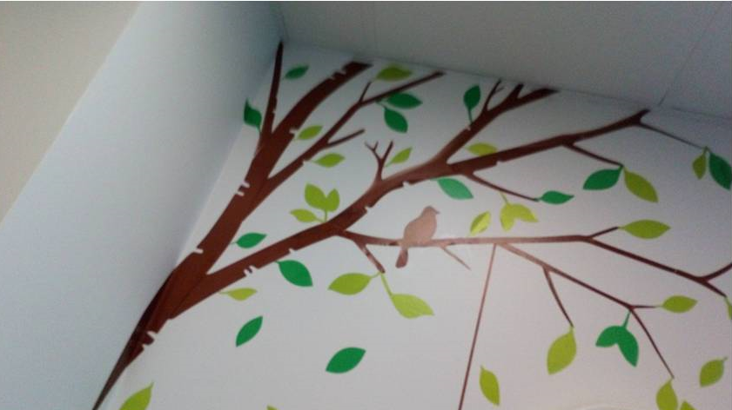
Notes:
Environmental changes and family involvement

Slide 16

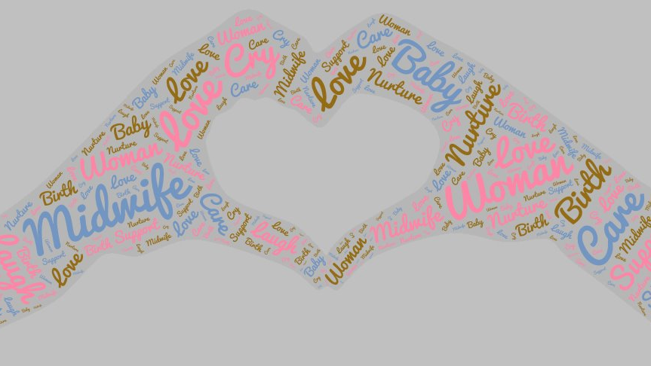



Feedback from women and families

Slide 17

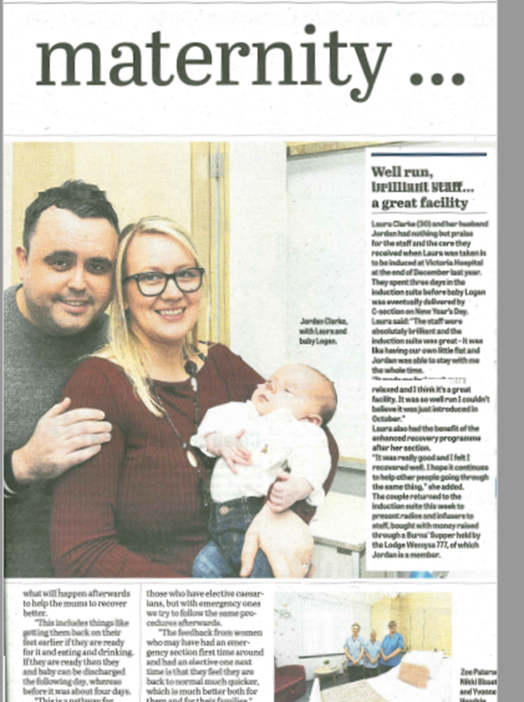
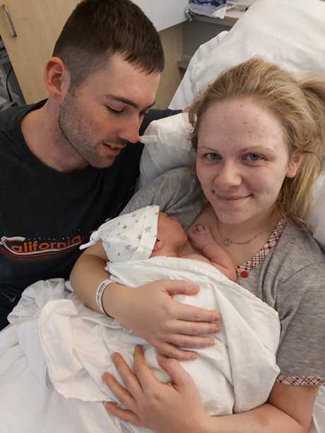
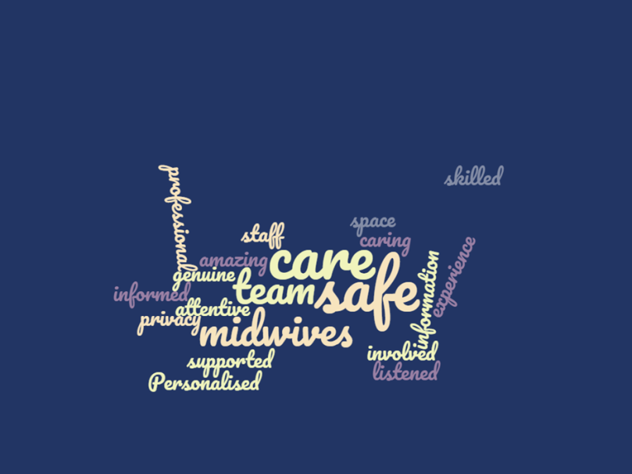
Feedback from women and families
..the stories

Slide 18
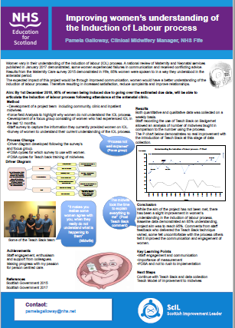
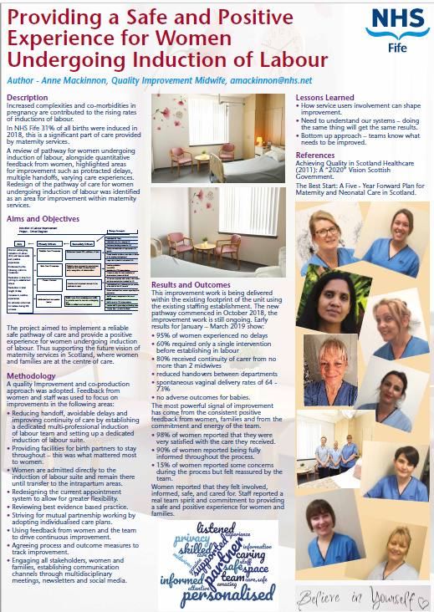

National
interest

Slide 19
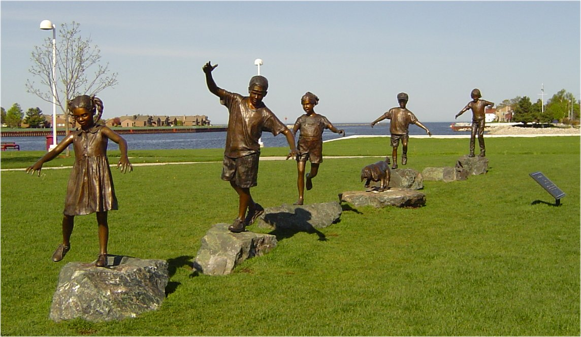
The improvement journey continues

Slide 20

Use of local data for informing choice
Complementary therapies
Post Dates Clinic

Slide 21

Thanks to the multidisciplinary teams,
women and families who have contributed to this presentation
Pamela Galloway pamelagolloway@nhs.net
Anne Mackinnon amackinnon@nhs.net

